Slide 1
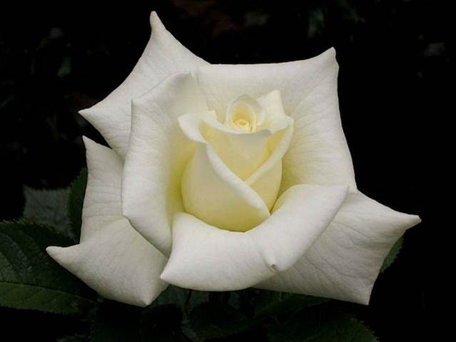
CHOICE ROSES FOR 2012: Latest and Classic
Tenarky Winter Workshop
~
Carol Shockley
Central Arkansas Rose Society

Slide 2
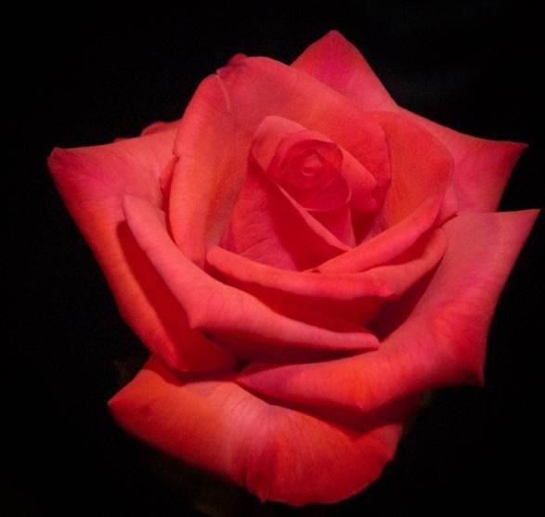
To love what you do and
feel that it matters - how
could anything be more
fun? – Katherine Graham

Slide 3
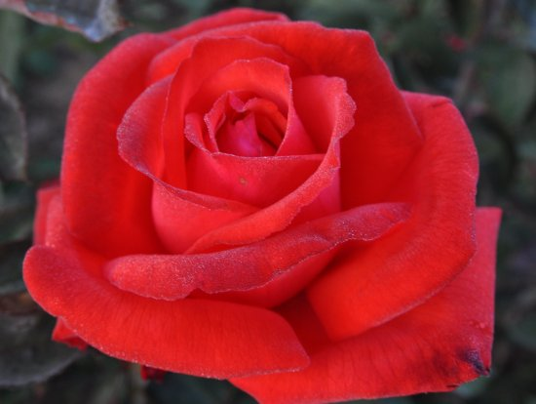
TOP TEN* CLASSIC ROSES
Touch of Class
Sally Holmes
Olympiad
Nicole
Pristine
Gold Medal
Mr. Lincoln
Sunsprite
Playboy
Europeana
Dolly Parton
(*Plus or minus ten or more…)
Photo by Bob Bauer

Slide 4
#1 TOUCH OF CLASS, Hybrid Tea~8.7
Star Roses Photo

Slide 5
#2 SALLY HOLMES, Shrub~8.9
Bob Bauer Photo

Slide 6
#3 OLYMPIAD, Hybrid Tea~8.5
Star Roses Photo

Slide 7
#4 NICOLE (Hannah Gordon), Floribunda~8.7
Star Roses Photo

Slide 8
#5 PRISTINE, Hybrid Tea~8.4
Bob Bauer Photo

Slide 9
#6 GOLD MEDAL, Grandiflora~8.3
Bob Bauer Photo

Slide 10
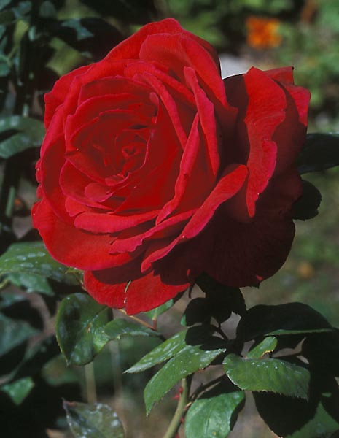
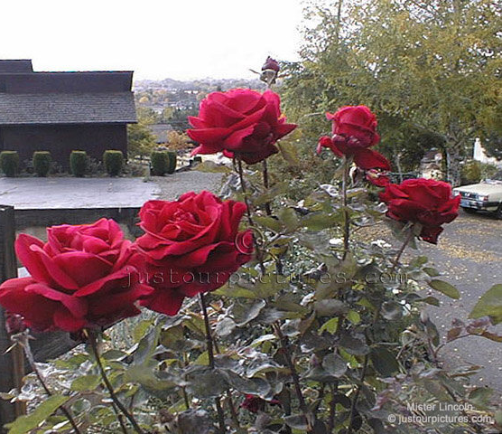
#7 MR. LINCOLN, Hybrid Tea~8.2
Bob Bauer Photos

Slide 11
#8 SUNSPRITE, Floribunda~8.4
Bob Bauer Photo

Slide 12
#9 PLAYBOY, Floribunda~8.5
Bob Bauer Photo

Slide 13
#10 EUROPEANA, Floribunda~8.4
Bob Bauer Photo

Slide 14
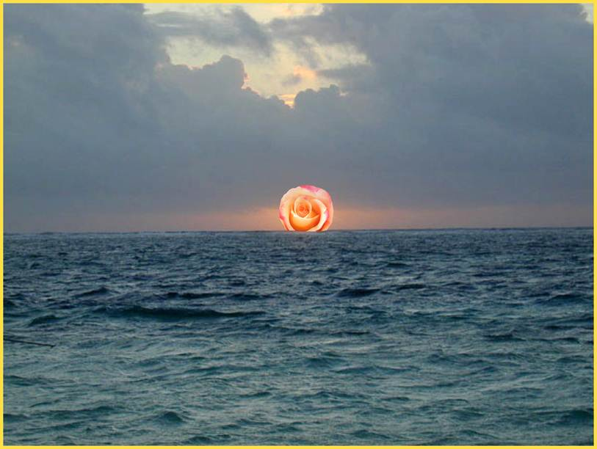
HORIZON ROSES: 2012
Slide courtesy of Bob Martin

Slide 15
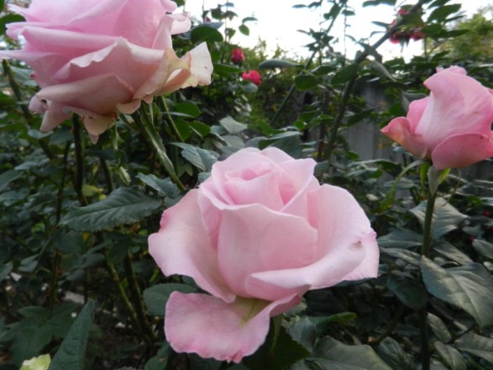
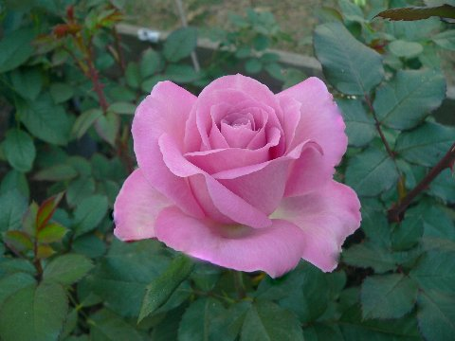
BROTHER JACK
Hybrid Tea
By Fred Wright
Photos by Meyer, Landberg and Shockley

Slide 16
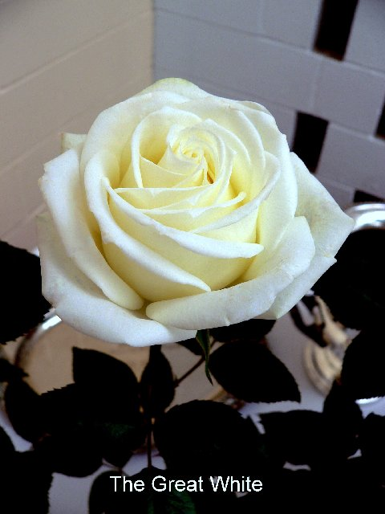
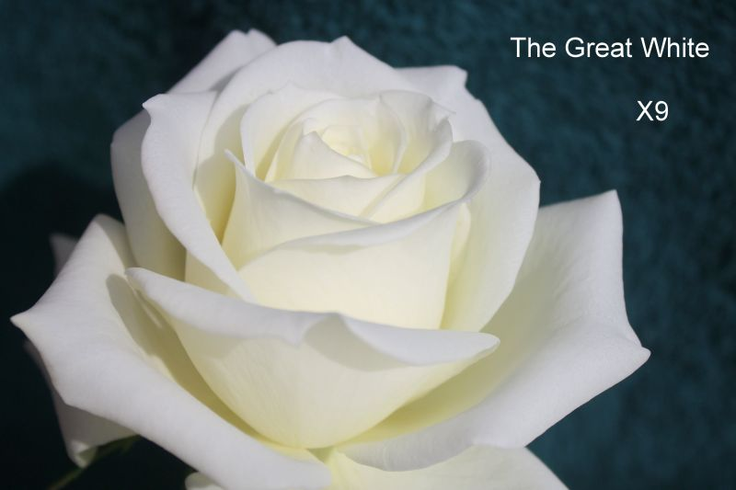
THE GREAT WHITE Hybrid Tea By Fred Wright
Photos by Fred Wright
and Larry Meyer

Slide 17
Fred Wright’s Hybrid Teas
CAROLINA PRIDE
MR. CALEB

Slide 18
SISTER RUBY Hybrid Tea by Fred Wright
Photos by Fred Wright and Carol Shockley

Slide 19
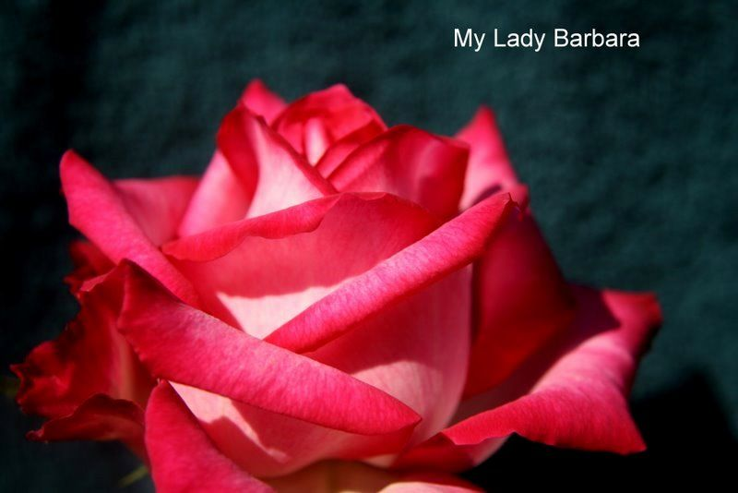
MY LADY BARBARA
Hybrid Tea
By Fred Wright
Photos provided
By Fred Wright &
Larry Meyer

Slide 20
Fred Wright’s Hybrid Teas
HEY, JACK
PHILLIP’S GRAND SLAM
Photos by Fred Wright

Slide 21
SECRET LADY Hybrid Tea by Fred Wright
Photo by Fred Wright

Slide 22
ALMOST HEAVEN Hybrid Tea by Fred Wright
Photo by Fred Wright

Slide 23
EDDIE EDWARDS Hybrid Tea by Fred Wright
Photo Courtesy of Fred Wright

Slide 24
BOLD AND BEAUTIFUL Hybrid Tea by Fred Wright
Photo by Fred Wright

Slide 25
MISS TERRANY
Hybrid Tea
By Fred Wright
Photo Courtesy of Fred Wright

Slide 26
MS JAN Hybrid Tea By Fred Wright
Photo Courtesy of Fred Wright

Slide 27
Hybrid Teas by Fred Wright
SISTER JANE
LOVING YOU
Photos by Fred Wright

Slide 28
TOP GUN Hybrid Tea By Fred Wright
Photo Courtesy of Fred Wright

Slide 29
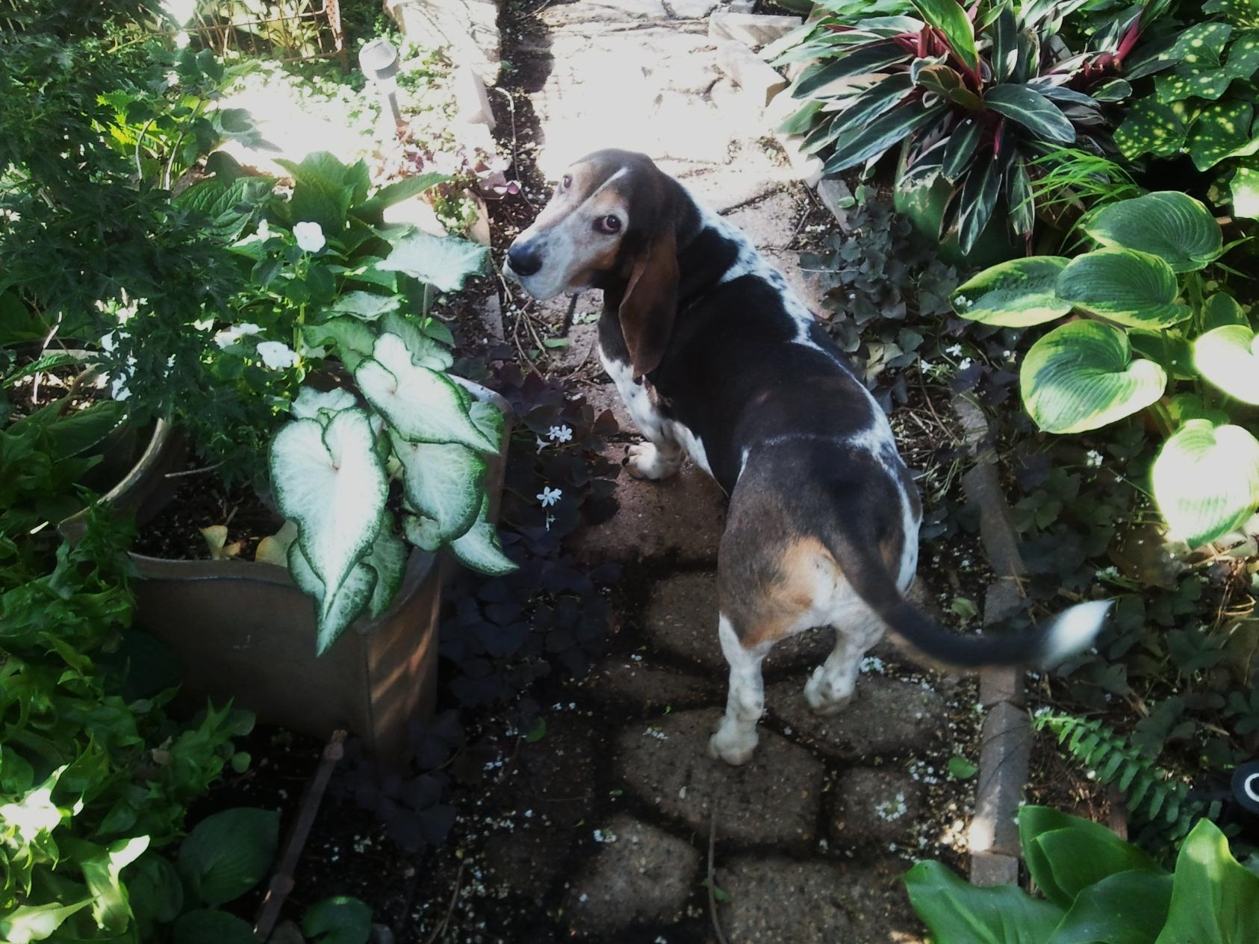
Let’s go see what’s blooming!

Slide 30
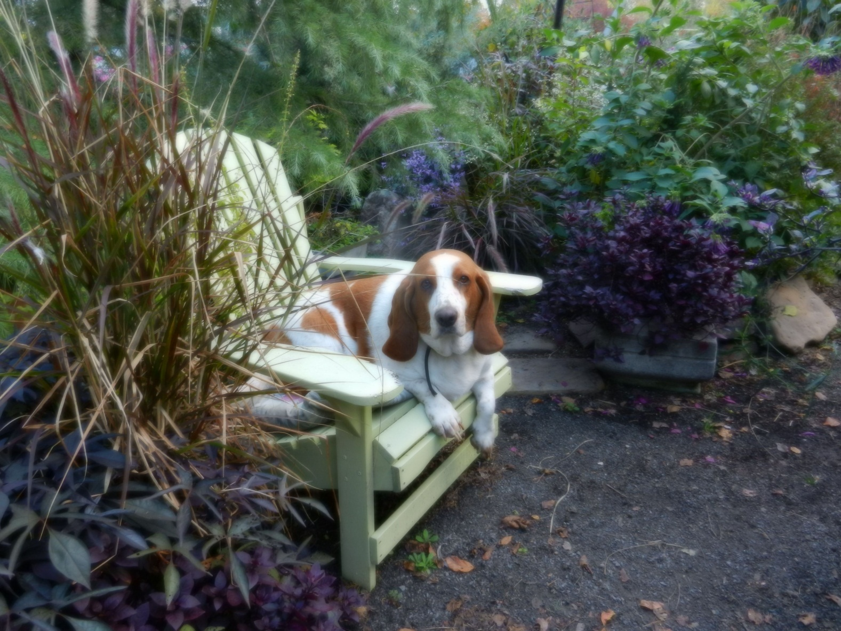
Or…just sit down and rest a spell…

Slide 31
RANDY SCOTT Hybrid Tea by John Smith
Photos by Larry Meyer
&
Andrew Hearne >

Slide 32
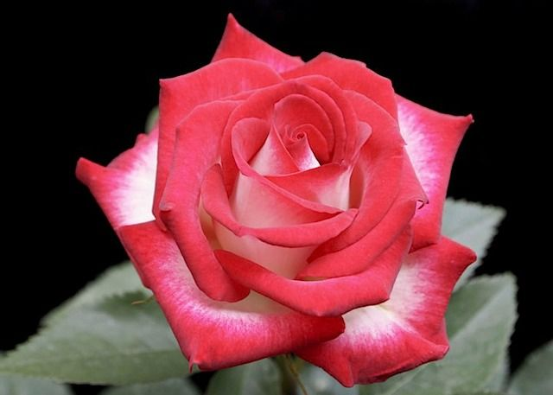
DINA GEE Hybrid Tea by John Smith
Photo by Andrew Hearne

Slide 33
SNUFFY
Hybrid Tea
By John Smith
Photo by Dona Martin

Slide 34
JACQUELINE POWERS Hybrid Tea by John Smith
Photo Provided by John Smith

Slide 35
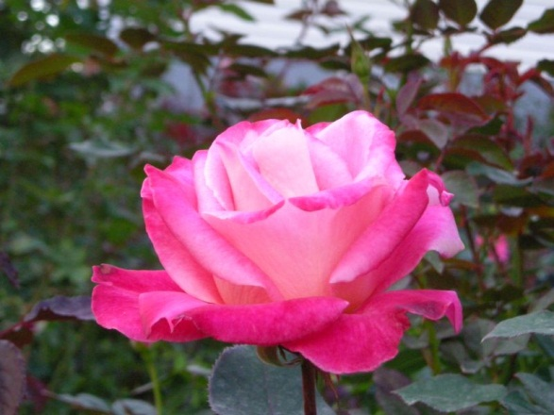
SOULMATE
Hybrid Tea
By John Smith
Photo Provided by John Smith

Slide 36
HOWARD AND SARA Hybrid Tea by John Smith
Photo Provided by John Smith

Slide 37
AUTUMN SPICE Hybrid Tea by John Smith
Photo Provided by John Smith

Slide 38
John Smith’s Hybrid Tea Seedlings
Photos provided by John Smith

Slide 39
More of John Smith’s Hybrid Tea Seedlings
Photos provided by John Smith

Slide 40
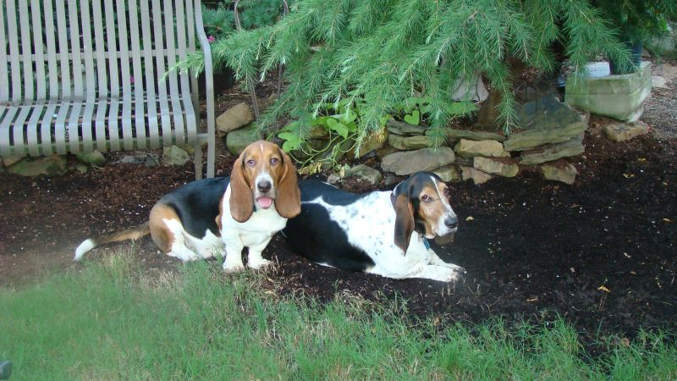
Duke and Hank after a hard day of watering their roses and hunting lizards…

Slide 41
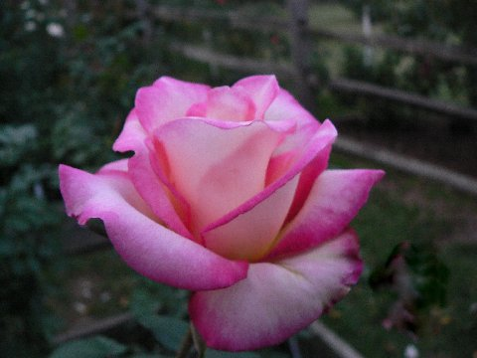
LAURA V Hybrid Tea by Eddie Edwards
Larry Meyer photos

Slide 42
Eddie Edwards’ 2010 Seedlings
#1
#2
Photos by Larry Meyer

Slide 43
Introducing newly registered roses from one of the “Grow‘em, Show‘em and Share’em” guys from South Texas. Tommy Hebert

Slide 44
SHUG Hybrid Tea by Tommy Hebert
Photo by Tommy Hebert

Slide 45
MISS TIS Hybrid Tea by Tommy Hebert
Photo by Tommy Hebert

Slide 46
RESA G
Hybrid Tea
By Tommy Hebert
Photo by Tommy Hebert

Slide 47
SUPER NOVA Hybrid Tea by Tommy Hebert
Photo by Tommy Hebert

Slide 48
MADISON GRACE Floribunda by Tommy Hebert
Photo by Tommy Hebert

Slide 49
Thelma G, Floribunda by Tommy Hebert
Photo by Tommy Hebert

Slide 50
ROSES FROM THE PROs Zary, Carruth and Bedard
Crescendo
By Keith Zary

Slide 51
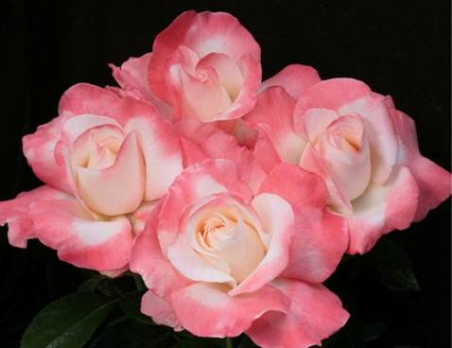
CRESCENDO Hybrid Tea by Keith Zary
J & P photo

Slide 52
SUMMER NIGHTS Hybrid Tea by Keith Zary
J & P Photo

Slide 53
LOVE’S KISS
Hybrid Tea
By Keith Zary
J & P Photo

Slide 54
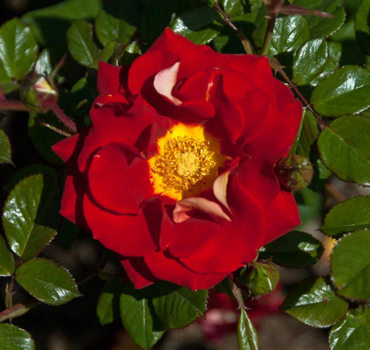
KETCHUP AND MUSTARD Floribunda by Christian Bedard
Weeks Roses Photo

Slide 55
SUGAR MOON Hybrid Tea by Christian Bedard
Weeks Roses Photo

Slide 56
DICK CLARK
Grandiflora
By Tom Carruth and
Christian Bedard
Weeks Roses Photo

Slide 57
OH MY Floribunda by Christian Bedard
Weeks Roses Photo

Slide 58
BULLSEYE Shrub by Peter James
Weeks Roses Photo

Slide 59
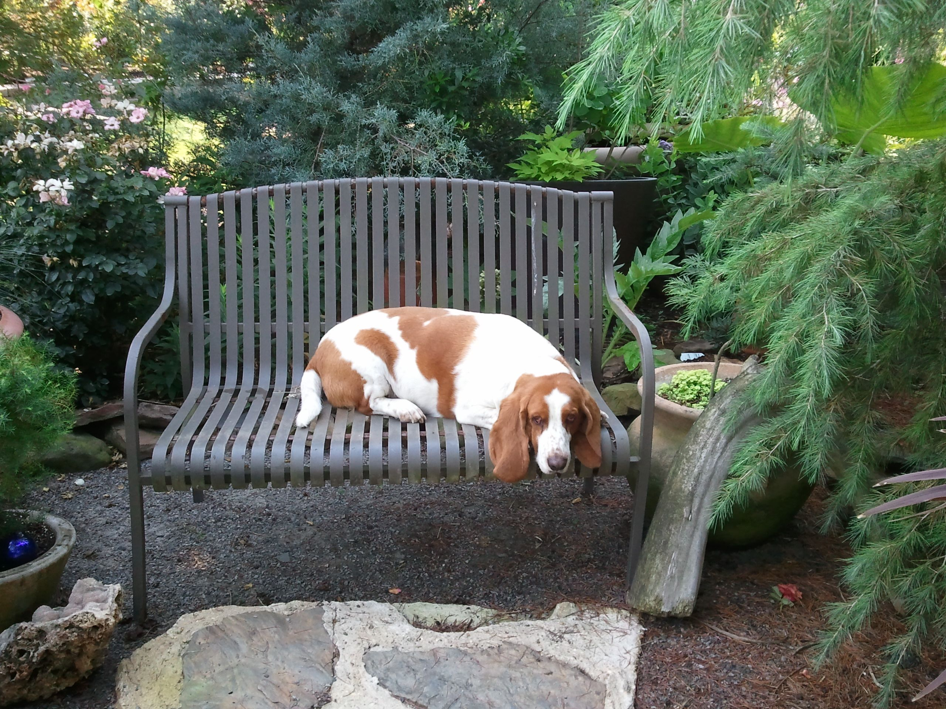
Rex always finds the best seat in the garden…

Slide 60
PEACHY CHEEKS Floribunda by Bob Martin
Photo by Dona Martin

Slide 61
DONA MARTIN
Hybrid Tea
By Bob Martin
Photo by Dona Martin

Slide 62
MISS KITTY by Kitty Belendez Hybrid Tea Sport of Cajun Moon
Photo by
Kitty Belendez

Slide 63
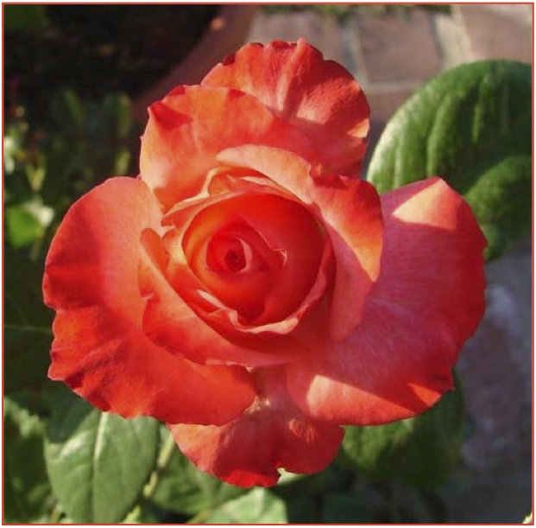
CRISTINA LYNNE by Kitty Belendez Floribunda Sport of Pinnacle
Photos by Kitty Belendez

Slide 64
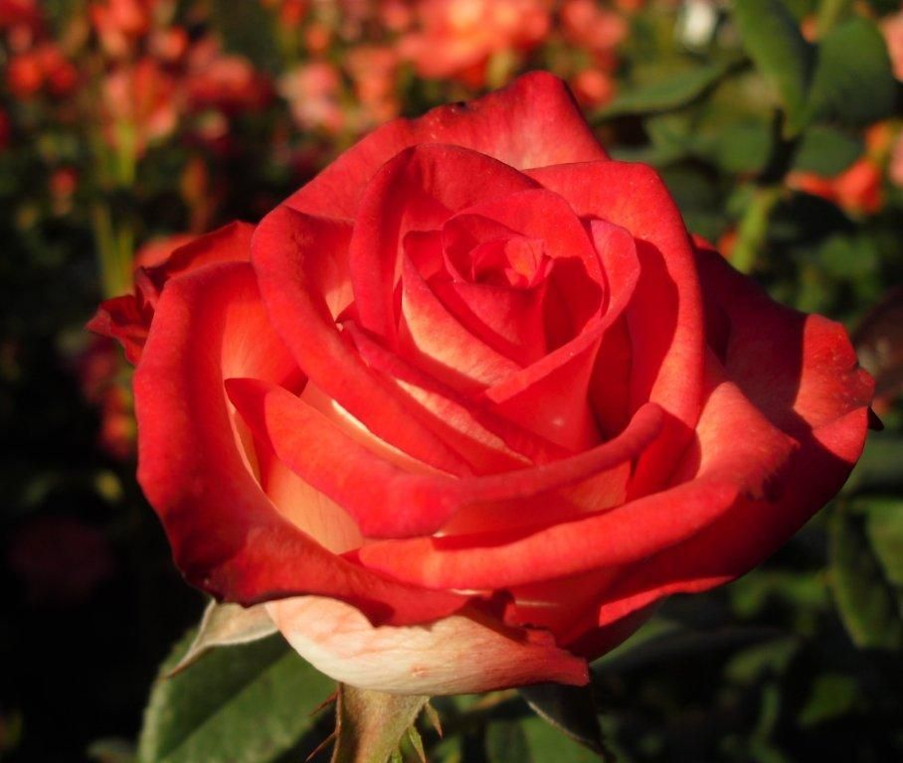
HAROLD’S PRIDE Floribunda by Vernon Rickard
Photo by Sandy Lundberg
and Vernon Rickard

Slide 65
LORETTA LYNN VAN LEAR Floribunda by Brad Jalbert
Photos provided by
Brad Jalbert

Slide 66
PACIFIC CELEBRATION Hybrid Tea by Frank Strickland
Photo by Sandy Landberg

Slide 67
ISABELLE, Hybrid Tea Florist Rose
Photo by Steve Singer

Slide 68
IMPULSE Hybrid Tea by Tantau
Photo by Kitty Belendez

Slide 69
STEPHEN RULO Grandiflora by William Chaney
Photo by Steve Singer

Slide 70
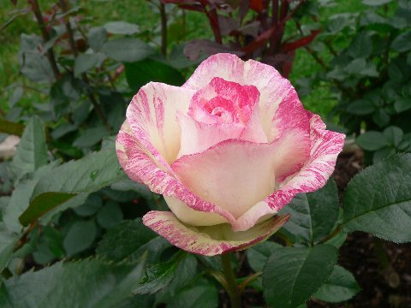
GRANDMA DEE
HYBRID TEA
By Larry Meyer
Sport of Moonstone
Photo by Meyer

Slide 71
PAROLE (aka Buxom Beauty)
Hybrid Tea
By Kordes
Photo Courtesy of Steve Singer

Slide 72
FIFI Floribunda by Henson
Photo by Steve Singer

Slide 73
TONIA NORRIS ~Sport of Gentle Giant
Hybrid Tea
By Luis Desamero
Photo Provided by Steve Singer

Slide 74
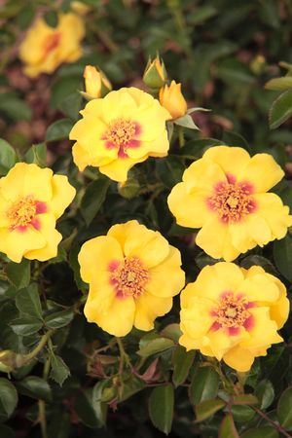
Sproul’s Eyeconic Roses
PINK LEMONADE
Photos by Star Roses
LEMONADE

Slide 75
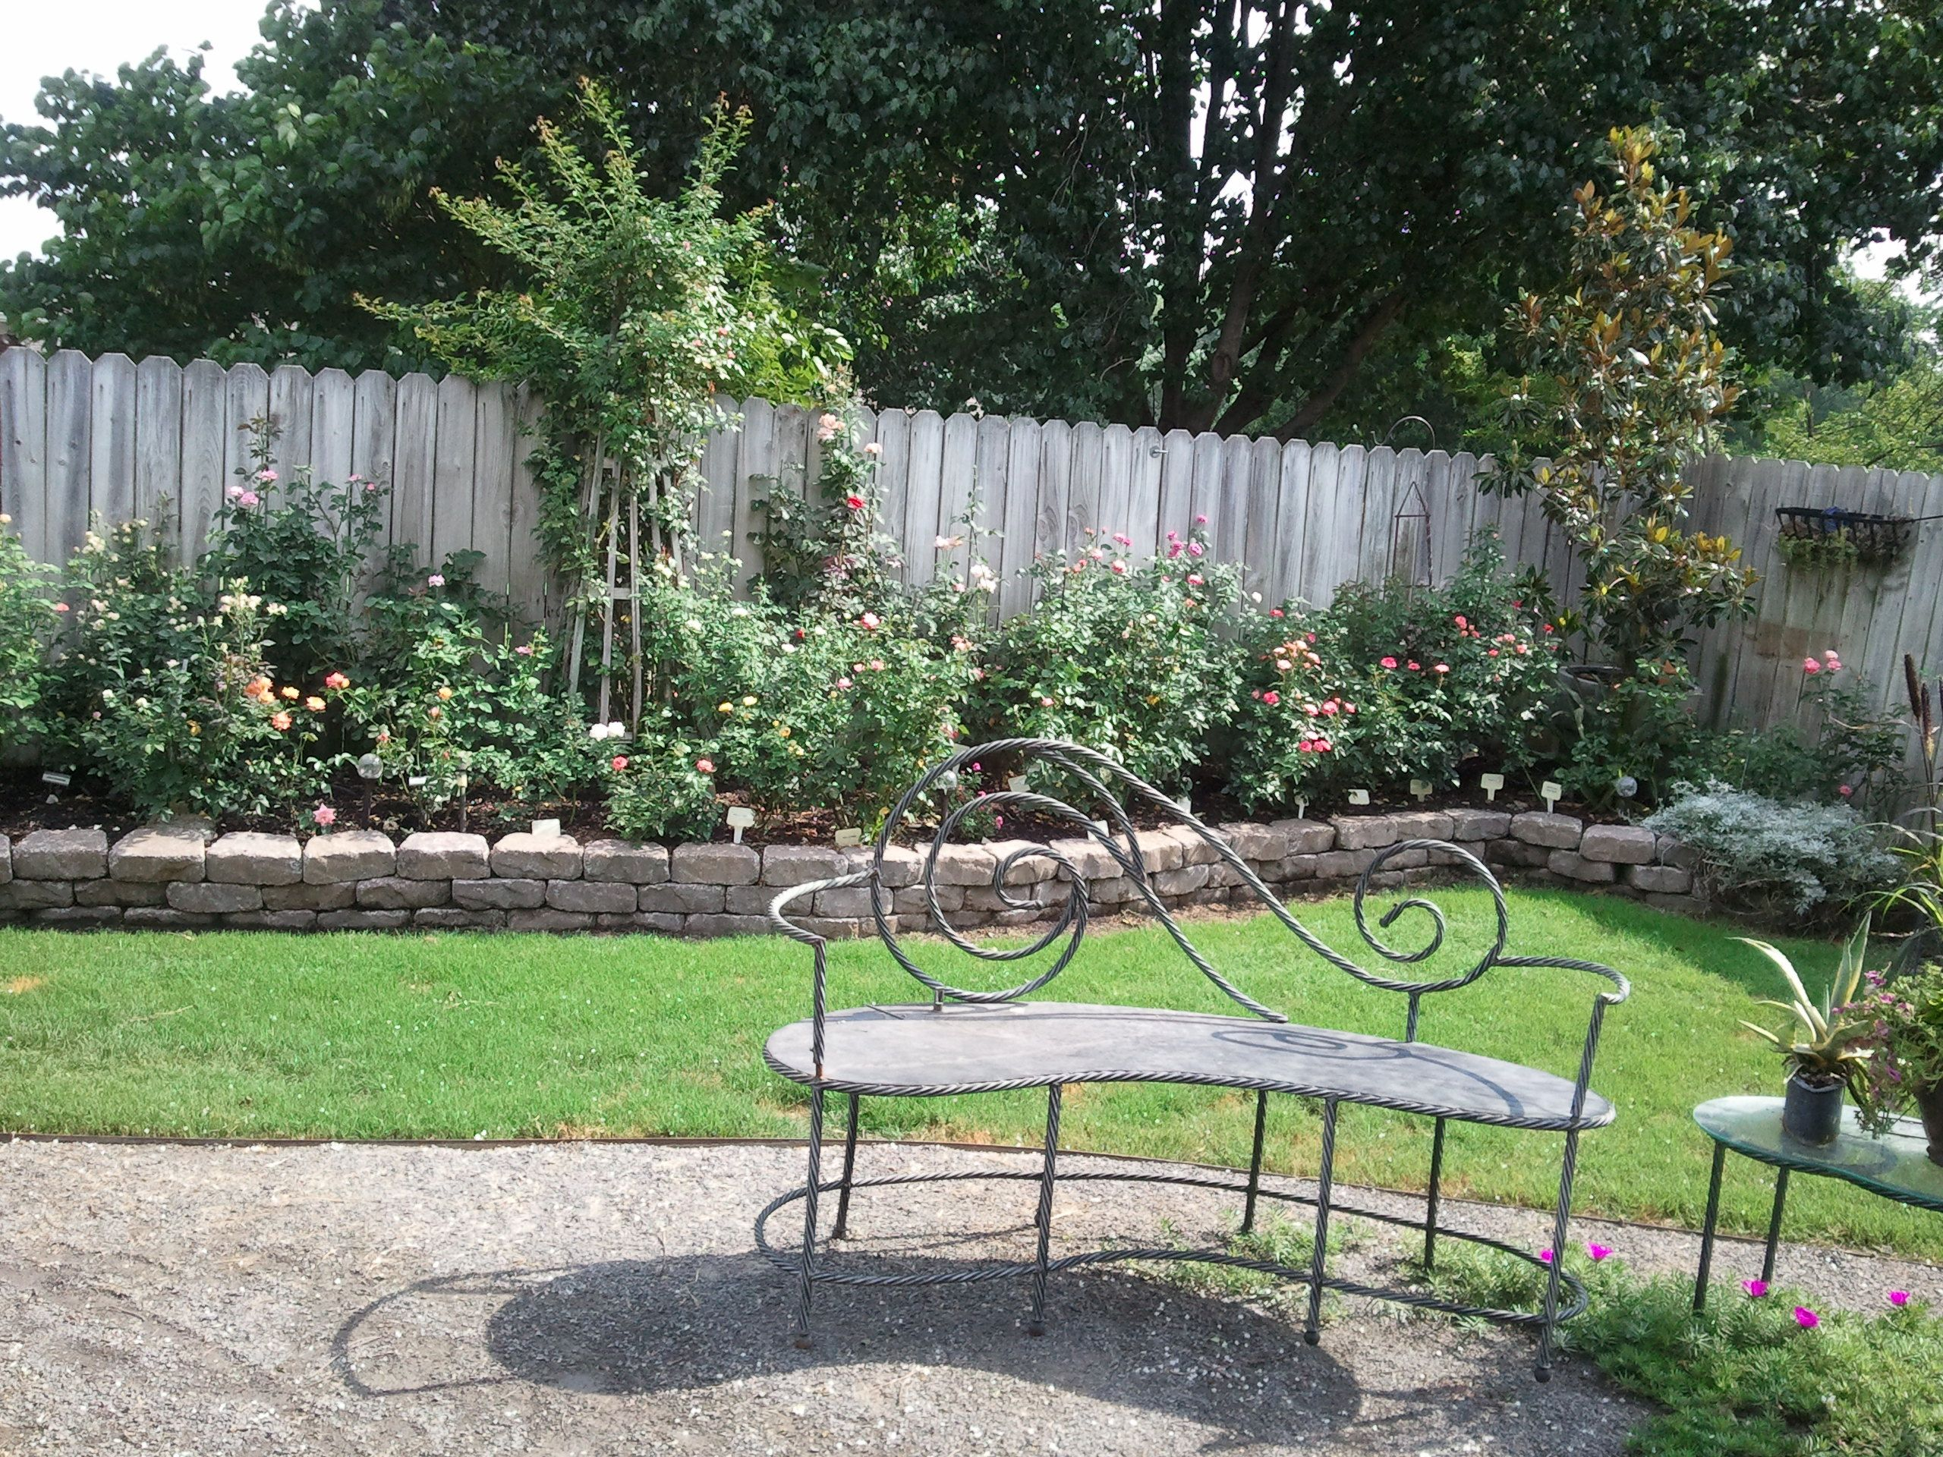
Minis get royal treatment in Carol’s garden…

Slide 76
MAGIC SHOW MINIATURE By Frank Benardella
Photo by Dona Martin

Slide 77
FIRST AND FOREMOST
Miniflora
By Frank Benardella

Slide 78
PATRON Miniflora by Frank Benardella

Slide 79
SANDY’S PICK (BENsandy) Miniflora by Frank Benardella
Photo by Sandy Lundberg

Slide 80
POWERHOUSE Miniflora by Frank Benardella
Photo by Dona Martin

Slide 81
Benardella Seedlings
BENbrave
BENStri

Slide 82
ALYSHEBA Miniature by David Clemons
Photo by Peter Alonso

Slide 83
GHOSTZAPPER Miniflora by David Clemons
Photos by Clemons and Rosemania
Notes:
NO REPORTS ON THIS BABY BUT I’M GUESSING IT’S A GOODIE. MADE COURT IN ITS FIRST OUTING. ROSEMANIA ONLY.

Slide 84
JOY
Miniature
By David Clemons
Andrew Hearne’s prizewinning photo and Queen of Show

Slide 85
WHIRLAWAY
Miniflora
By David Clemons
Photo by Andrew Hearne

Slide 86
Clemons’ Seedlings
2-05-20
4-06-1

Slide 87
Clemons’ Seedlings
12-10-04
22-07-01

Slide 88
Clemons’ Seedlings
30-06-01
30-03-3

Slide 89
The Ears Have IT !

Slide 90
KLASSY LADY, Miniature Sport of Miss Flippins by Klassy
Photo by Peter Alonso

Slide 91
PAULA SMART (aka Smart N Sassy)
Miniflora
By Brad Jalbert
Photo by Brad Jalbert

Slide 92
MELANIE DOWE Miniflora by Brad Jalbert
Photo by Brad Jalbert

Slide 93
LITTLE MUFF Miniature by Colin Horner
Photo by Steve Singer

Slide 94
THE LIGHTHOUSE Miniature by Jim Sproul
Photo by Kitty Belendez

Slide 95
COOPER Miniflora by Michael Williams

Slide 96
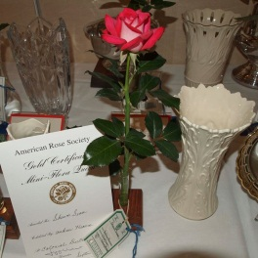
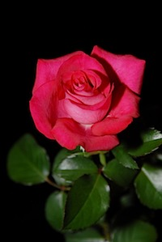
SHAWN SEASE Miniflora by Michael Williams

Slide 97
MARY PICKERSGILL, Miniflora by Michael Williams
Courtesy photo

Slide 98
MARY ALICE
Miniflora
By Fred Wright
Photo by Fred Wright

Slide 99
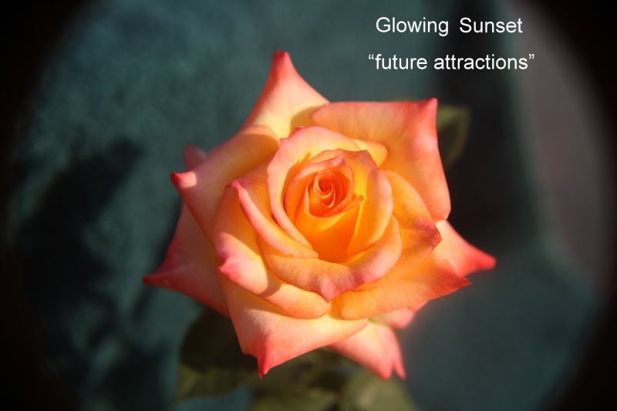
GLOWING SUNSET Miniflora by Fred Wright
Photos by Fred Wright

Slide 100
PRINCESS KATELYN Miniflora by Fred Wright
Photo by Fred Wright

Slide 101
Wright’s Miniflora Seedling
Photo by Fred Wright

Slide 102
VERNON’S DREAM Miniflora by Fred Wright
Photo by Fred Wright

Slide 103
SEATTLE SUNRISE
Miniflora
By Mitchie Moe

Slide 104
INTIMIDATOR Miniature by Vernon Rickard
Photo by Sandy Lundberg

Slide 105
ETERNITY
Miniflora
By Vernon Rickard
Photo by Vernon Rickard

Slide 106
Whit Wells and
Robbie Tucker…we’re awaiting your new creations…

Slide 107
CINNAMON GIRL Miniature by Keith Zary
Photo by Dona Martin

Slide 108
Diamond Eyes Miniature by Tom Carruth
Weeks Roses Photo

Slide 109
Hello, Gorgeous!
Miniature
By Chris Greenwood
Courtesy Photo

Slide 110
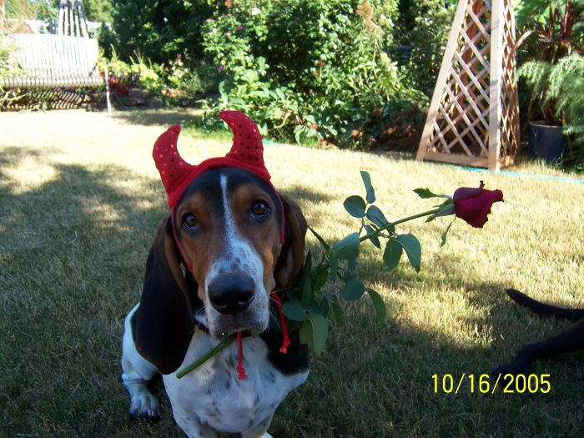
Adios from
The Rose Devil…

Slide 111
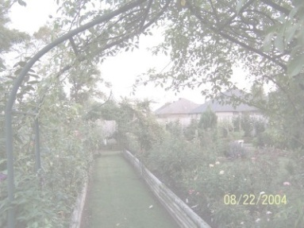
MANY THANKS to Fred Wright, Tommy Hebert, Bob Martin, Steve Singer, Larry Meyer, Sandy Lundberg, John Smith, Brad Jalbert and Jack Dickson for sharing their thoughts and pictures. You are the best!
Carol

Slide 112
SOURCES: HORIZON ROSES
AND AMERICAN ROSE EXHIBITORS’ SOCIETY
WRIGHT’S SISTER RUBY
Courtesy Photo

