Slide 1
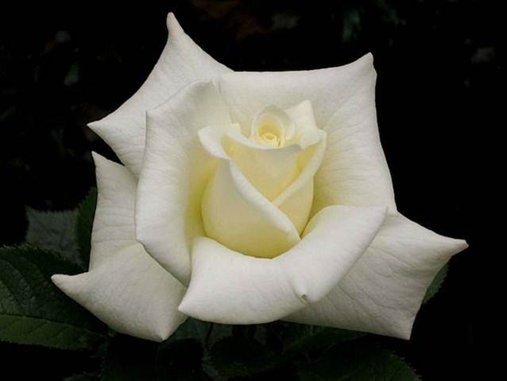
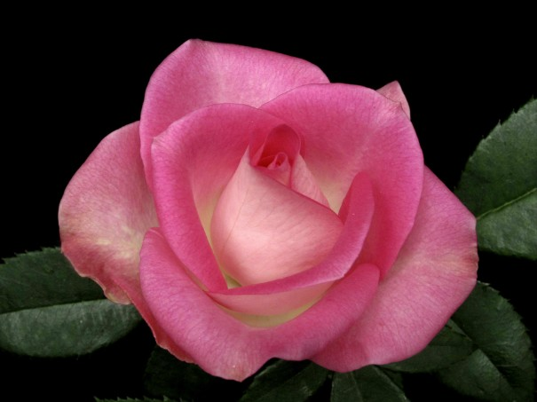
CHOICE ROSES FOR 2012: Latest and Classic
Great Rose
Choices For 2013
Tenarky Winter Workshop
Carol Shockley
Central Arkansas Rose Society
February 9, 2013

Slide 2
HYBRID TEAS
Moonstone

Slide 3
Heads up it’s SHOWTIME!

Slide 4
DAVID’S LOVE
Hybrid Tea by
Fred Wright
Photo by Fred Wright

Slide 5
SWEET MARLON Hybrid Tea by Fred Wright
Photo by Fred Wright

Slide 6
MOM AND POP WRIGHT Hybrid Tea by Fred Wright
Photo by Fred Wright

Slide 7
MAGNIFICENCE Hybrid Tea by Fred Wright
Photo by Fred Wright

Slide 8
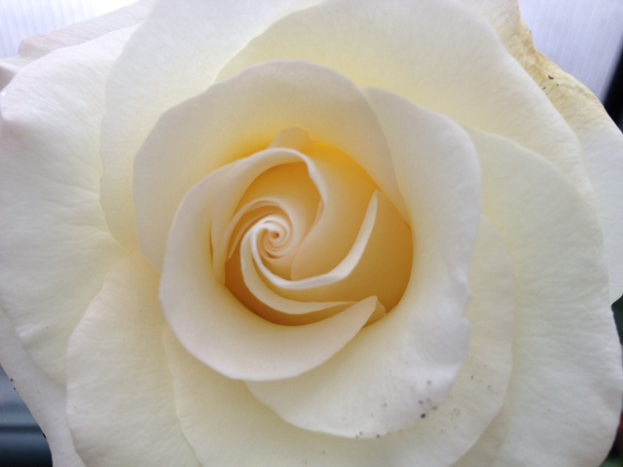
DONNA’S GRACE
Hybrid Tea by Fred Wright
Photos by
Fred Wright
and Carol
Shockley

Slide 9
MY MARY ANN Hybrid Tea by Fred Wright
Photo by Fred Wright

Slide 10
SUNDAY EVENING Hybrid Tea by Fred Wright
Photo by Larry Meyer

Slide 11
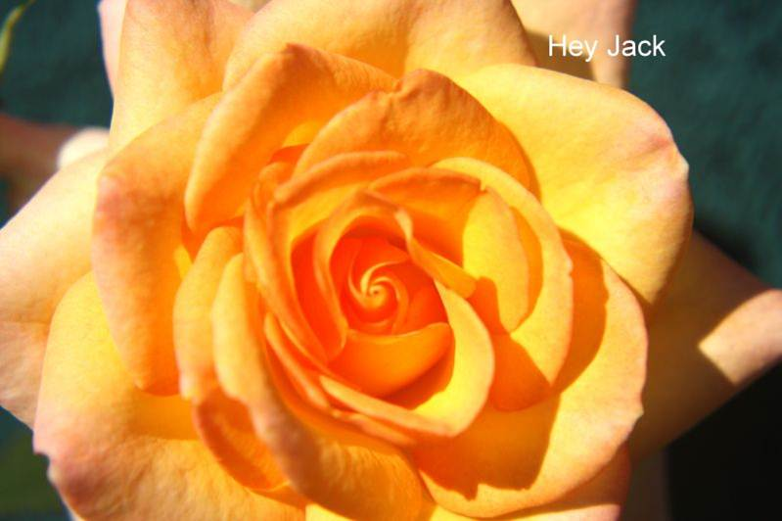
Hybrid Teas by Fred Wright
HEY JACK
FIRE LADY
Photo by Fred Wright

Slide 12
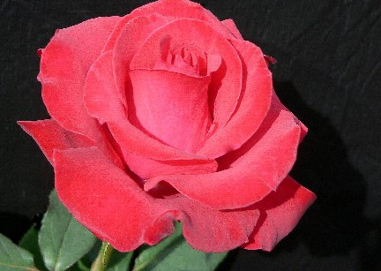
MR. CALEB Hybrid Tea by Fred Wright
Photos by Larry Meyer

Slide 13
MISS KATELYN Hybrid Tea by Fred Wright
Photo by Fred Wright

Slide 14
BROTHER JACK Hybrid Tea by Fred Wright
Photo by Larry Meyer

Slide 15
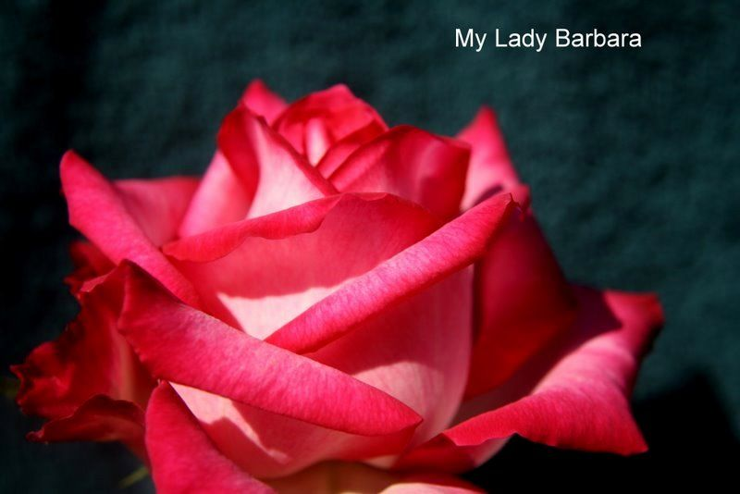
MY LADY BARBARA Hybrid Tea by Fred Wright
Photos by Fred Wright & Dona Martin

Slide 16
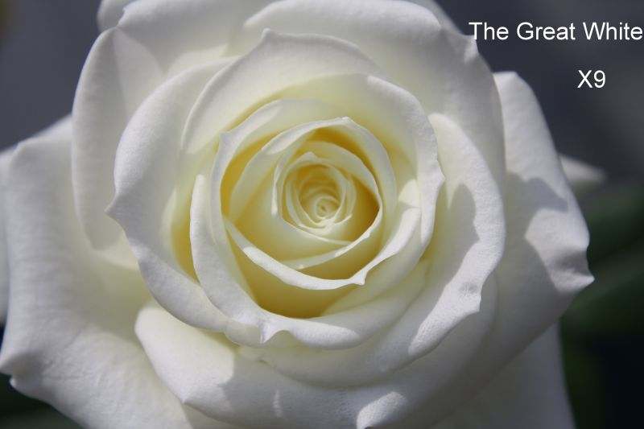
THE GREAT WHITE Hybrid Tea by Fred Wright
Photos by Fred Wright &
Larry Meyer

Slide 17
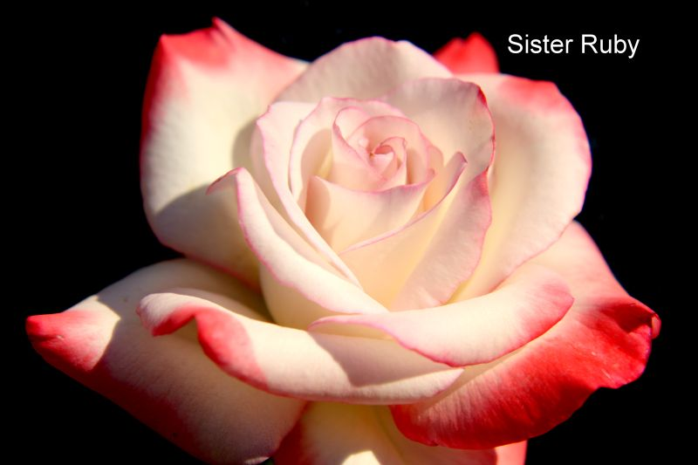
SISTER RUBY Hybrid Tea by Fred Wright
Photos by
Fred Wright and
Larry Meyer
Notes:
And here’s another of my favorites (I say that a lot)…SISTER RUBY. Grew very well and had exceptional form. Beautiful colors. NICE.

Slide 18
Fred Wright’s Hybrid Teas
Carolina Pride
PHILLIP’S GRAND SLAM
Photos by Fred Wright and Larry Meyer
Notes:
I haven’t grown either of these. Fred says Hey Jack “will win cycles of bloom and lots of queens”. Most colorful of all his roses. Phillip’s looks good; superior form. Named for baseball playing grandson. Per Fed could be better than Mr. Caleb.

Slide 19
EDDIE EDWARDS Hybrid Tea by Fred Wright
Photo Courtesy of Fred Wright
Notes:
Heard that Eddie was naming a rose for himself but Fred beat him to the punch. Lots of petals. It should be good. K&M this year.

Slide 20
BOLD AND BEAUTIFUL Hybrid Tea by Fred Wright
Photo by Fred Wright
Notes:
Large blooms; loves the heat. Gets darker with the sun. The name is an accurate description MOST of the time. K&M

Slide 21
Hybrid Teas by Fred Wright
SISTER JANE
LOVING YOU
Photos by Fred Wright and Carol Shockley
Notes:
Sister Jane is pink and yellow. Has excellent form and color. It did very well but my vote was for the other sister. Sister Ruby. Loving You is a beautiful ruffled ivory rose with good centers and size. It holds forever. Short bush in comparison to Fred’s other roses.

Slide 22
MS. JAN Hybrid Tea
Photo Courtesy of Fred Wright
Notes:
Looks wildly ruffledbut I’m going to try it. Maybe it just had a bad hair day! I’ll let you know more about it. K&M this year.

Slide 23
Hybrid Teas by Wright
SECRET LADY
ALMOST HEAVEN
Photos by Fred Wright

Slide 24
TOP GUN Hybrid Tea By Fred Wright
Photo Courtesy of Fred Wright
Notes:
Fred says this one has it all—color, form and size and to look for queens from it. The Top Gun club voted to name this rose..TOP GUN.

Slide 25
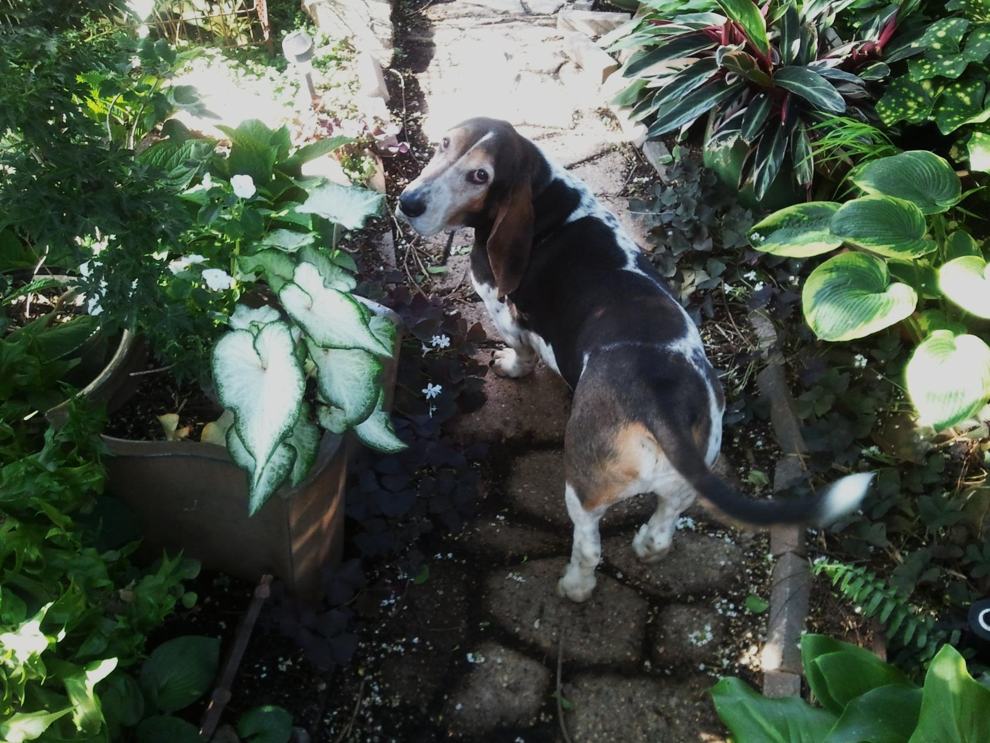
Let’s go see the HT’s blooming!

Slide 26
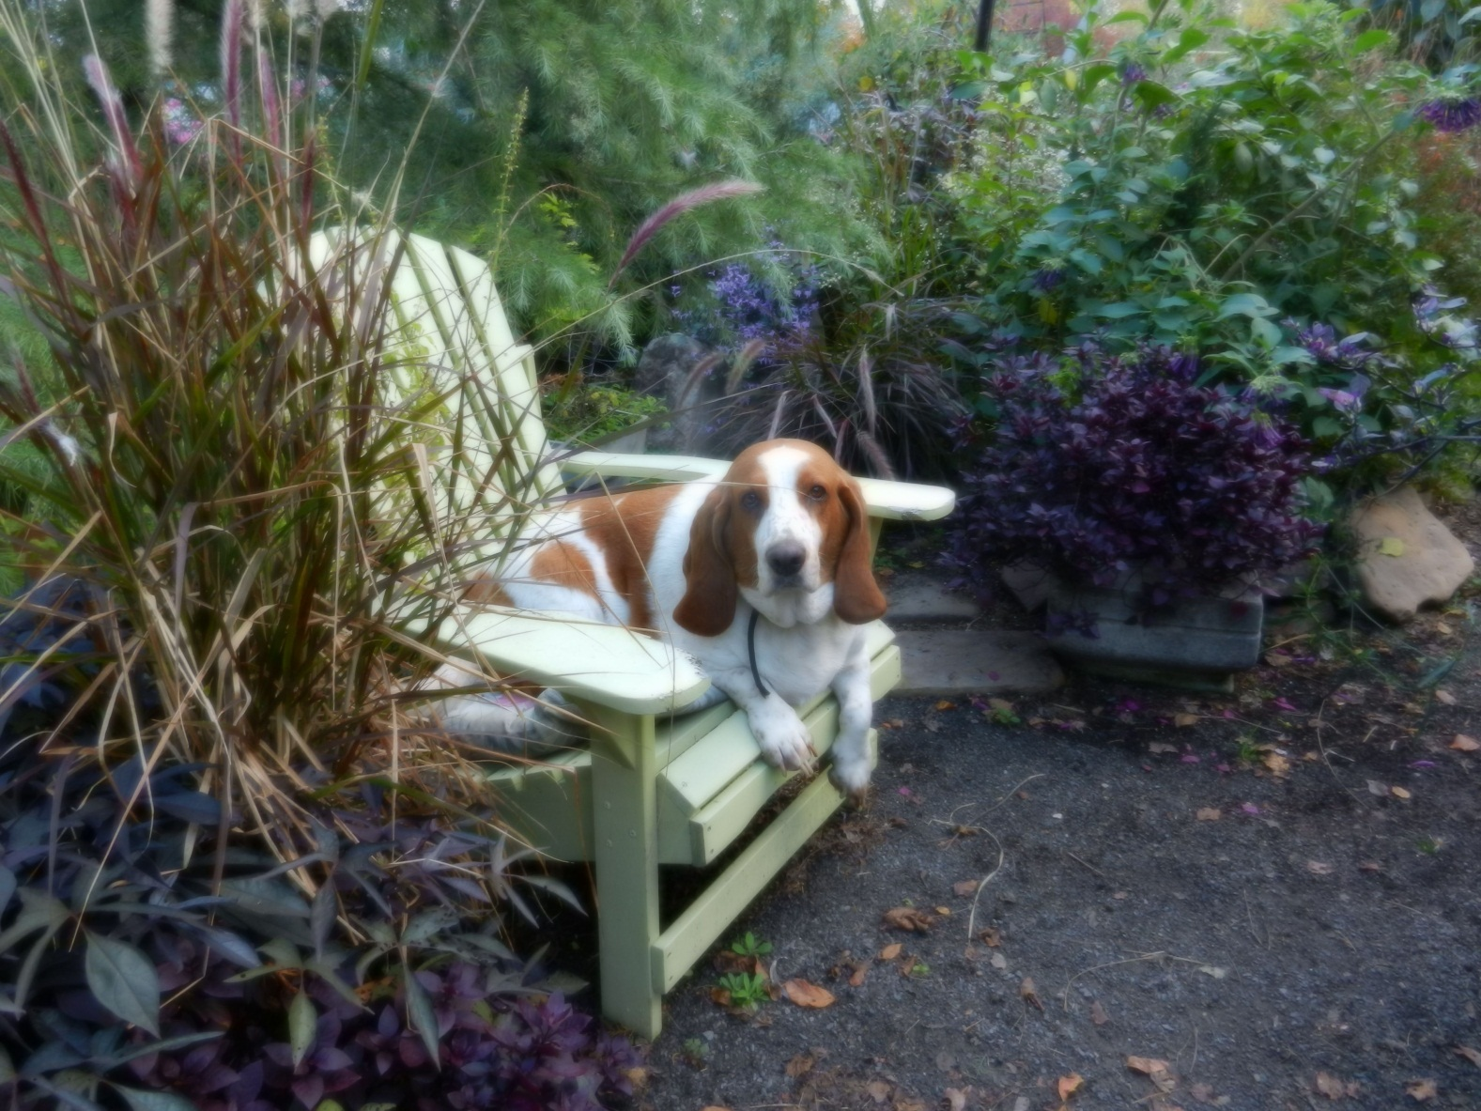
Or…just sit down and rest a spell…

Slide 27
RANDY SCOTT Hybrid Tea HT by John Smith
Photos by Larry Meyer
&
Andrew Hearne

Slide 28
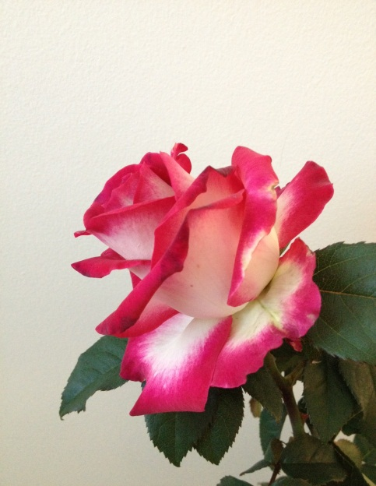
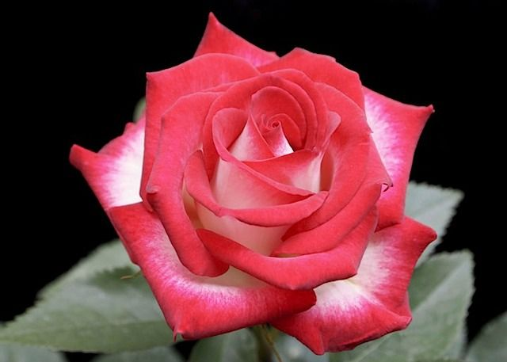
DINA GEE Hybrid Tea by John Smith
Photos by Andrew Hearne & Carol Shockley

Slide 29
SNUFFY
Hybrid Tea
By John Smith
Photo by Dona Martin

Slide 30
JACQUELINE POWERS Hybrid Tea by John Smith
Photo Provided by Larry Meyer

Slide 31
SOULMATE
Hybrid Tea
By John Smith
Photo by John Smith

Slide 32
AUTUMN SPICE Hybrid Tea by John Smith
Photo by John Smith

Slide 33
More of John Smith’s Hybrid Tea Seedlings
Photos by John Smith

Slide 34
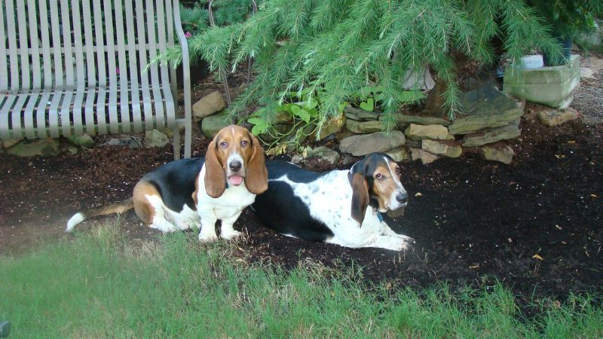
Duke and Hank working hard in the garden…

Slide 35
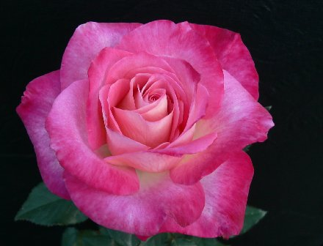
JEWEL GRACE
Hybrid Tea by Eddie Edwards
Photo by Larry Meyer

Slide 36
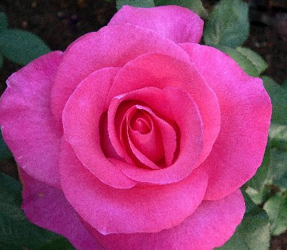
KAREN CONSTANT
Hybrid Tea by Eddie Edwards
Photo by Larry Meyer

Slide 37
SHUG Hybrid Tea by Tommy Hebert
Photo by Tommy Hebert

Slide 38
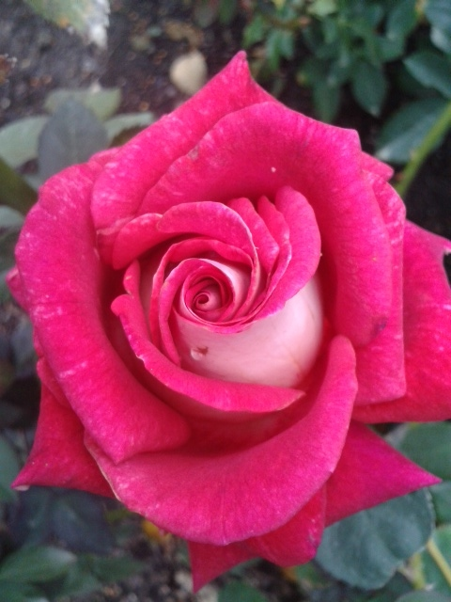
RESA G Hybrid Tea by Tommy Hebert
Photos by Tommy Hebert and
Carol Shockley

Slide 39
MISS TIS Hybrid Tea by Tommy Hebert
Photo by Tommy Hebert

Slide 40
SUPER NOVA Hybrid Tea by Tommy Hebert
Photo by Tommy Hebert

Slide 41
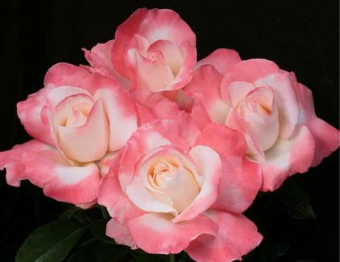
CRESCENDO Hybrid Tea by Keith Zary
J & P photos

Slide 42
LOVE’S KISS
Hybrid Tea
By Keith Zary
J & P Photo

Slide 43
DONA MARTIN Sport of Randy Scott
Hybrid Tea
By Bob Martin
Photo by Dona Martin

Slide 44
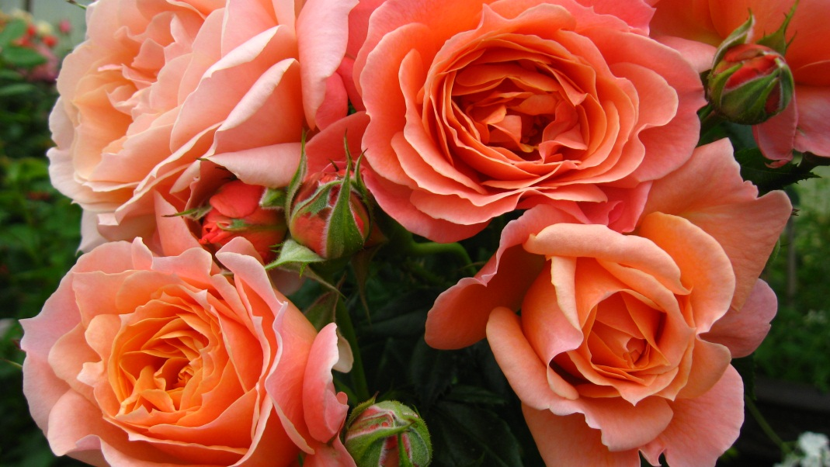
LORETTA LYNN VAN LEAR Floribunda by Brad Jalbert
Photos provided by
Brad Jalbert

Slide 45
LOUISE WOJCIECHOWSKI Hybrid Tea by Brad Jalbert
Photo by Brad Jalbert

Slide 46
BRAD JALBERT SEEDLING
Photo by Brad Jalbert

Slide 47
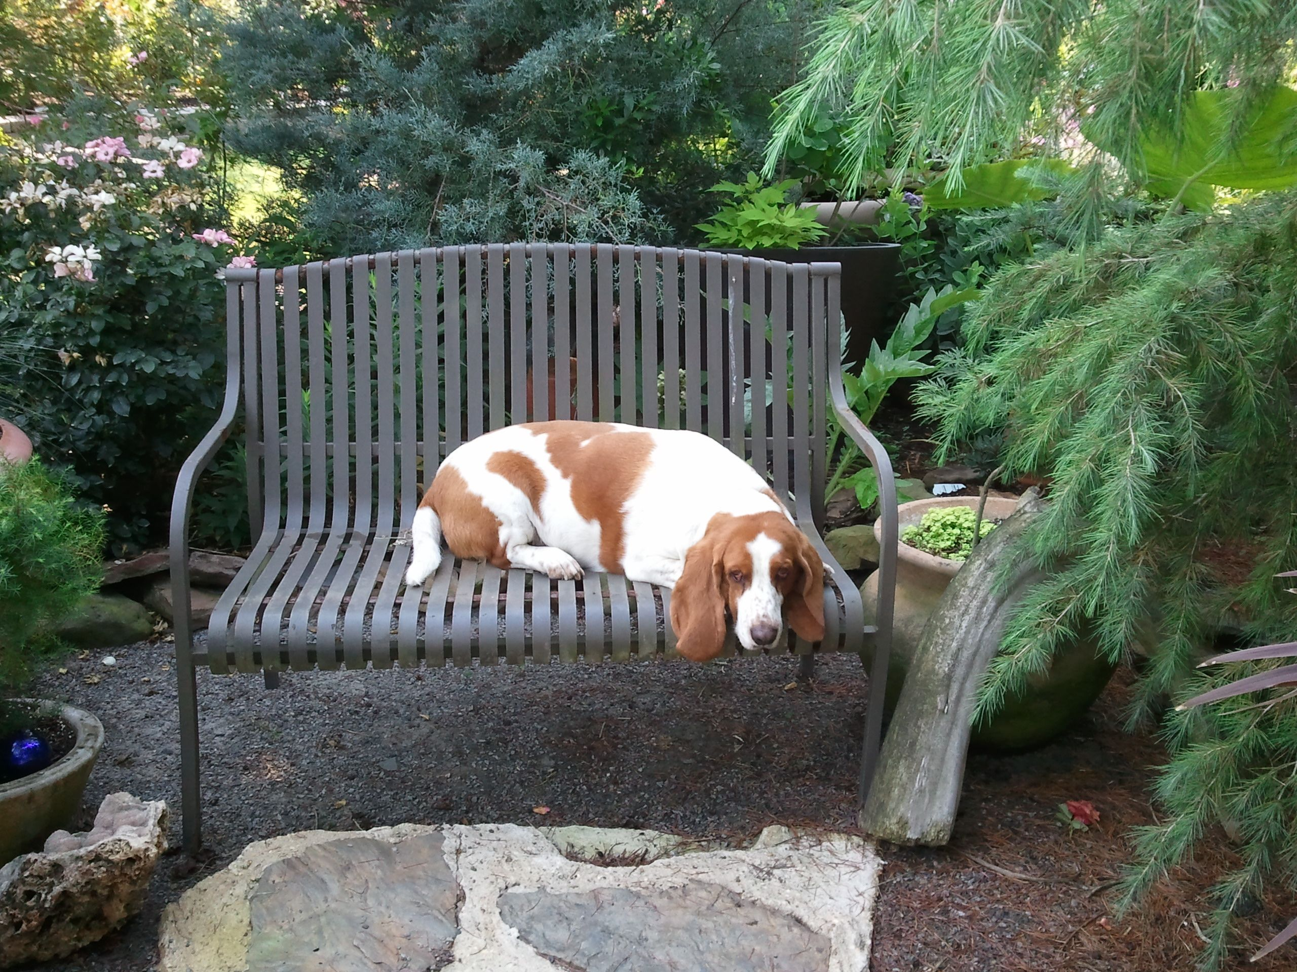
You should hear me howl!

Slide 48
MISS KITTY by Kitty Belendez Hybrid Tea Sport of Cajun Moon
Photo by
Kitty Belendez

Slide 49
CORETTA SCOTT KING Hybrid Tea by Christian Bedard
Weeks Courtesy Photo

Slide 50
PACIFIC CELEBRATION Hybrid Tea by Frank Strickland
Photo by Sandy Landberg

Slide 51
HOT LADY Hybrid Tea ~ Florist Rose
Photo Courtesy of Steve Singer

Slide 52
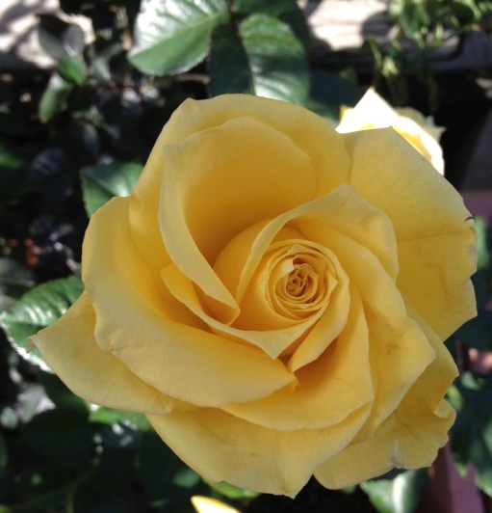
ISABELLE Hybrid Tea Florist Rose
Photos by Steve Singer and Carol Shockley

Slide 53
MILLS’ MAGIC Whit Wells’ HT Seedling
ForLoveOfRoses.Com Photo

Slide 54
WHIT WELLS’ SEEDLING Bosom Buddy x Raphaela
Photo by Larry Meyer

Slide 55
TONIA NORRIS ~Sport of Gentle Giant
Hybrid Tea
By Luis Desamero
Photo Courtesy of Steve Singer

Slide 56
JULIA’S KISS Hybrid Tea by Lionel Poole
Photo Courtesy of Steve Singer

Slide 57
FRANCIS MEILLAND Hybrid Tea by Meilland
Photo by Star Roses

Slide 58
GIRLS NIGHT OUT Hybrid Tea by Meilland

Slide 59
BIG MOMMA Hybrid Tea by Meilland

Slide 60
PAROLE (aka Buxom Beauty)
Hybrid Tea
By Kordes
Photo Courtesy of Steve Singer

Slide 61
GRAND AMORE`
Hybrid Tea by Kordes
Photo by Star Roses

Slide 62
STEPHEN RULO Grandiflora by William Chaney
Photo Courtesy of Steve Singer

Slide 63
Floribundas
Lounging around
in the garden…

Slide 64
MADISON GRACE Floribunda by Tommy Hebert
Photo by Tommy Hebert

Slide 65
Thelma G Floribunda by Tommy Hebert
Photo by Tommy Hebert

Slide 66
San Diego Sweetheart Floribunda by Frank Strickland
Photo Courtesy of Bob Martin

Slide 67
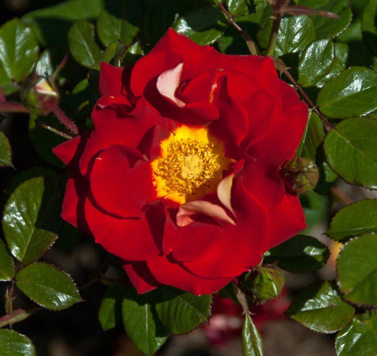
KETCHUP AND MUSTARD
Floribunda by
Christian Bedard
Weeks Roses Photo

Slide 68
PEACHY CHEEKS Floribunda by Bob Martin
Photo by Dona Martin

Slide 69
OH MY Floribunda by Christian Bedard
Weeks Roses Photo

Slide 70
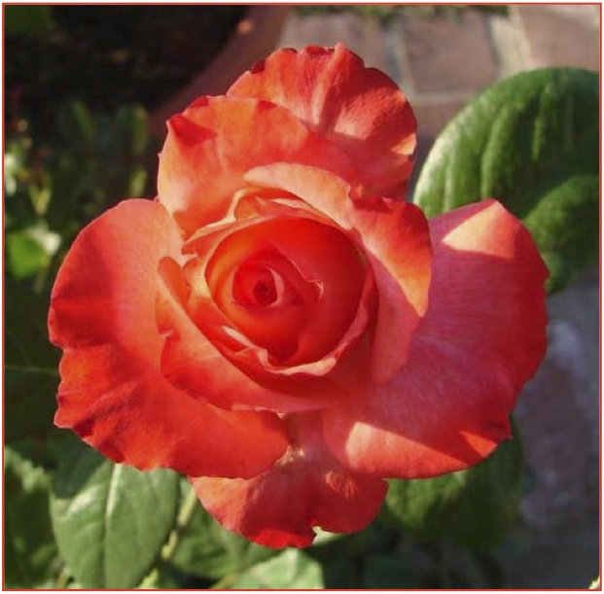
CRISTINA LYNNE by Kitty Belendez Floribunda Sport of Pinnacle
Photos by Kitty Belendez

Slide 71
FIFI Floribunda by Henson
Photo Courtesy
of Steve Singer

Slide 72
ME & MRS JONES Floribunda by Steve Jones
Photo by Sandy Lundberg

Slide 73
BULLSEYE Shrub by Peter James
Weeks Roses Photo

Slide 74
JOLENE ADAMS Floribunda by James Sproul
Photo by James Sproul

Slide 75
CHOOSE LIFE Floribunda by James Sproul
Photo by James Sproul

Slide 76
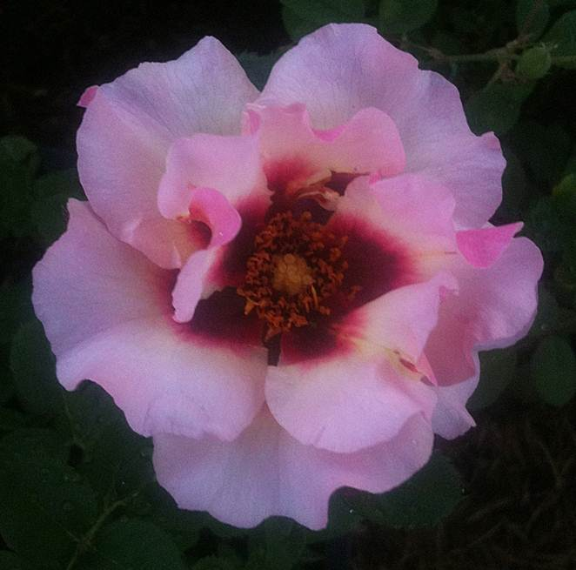
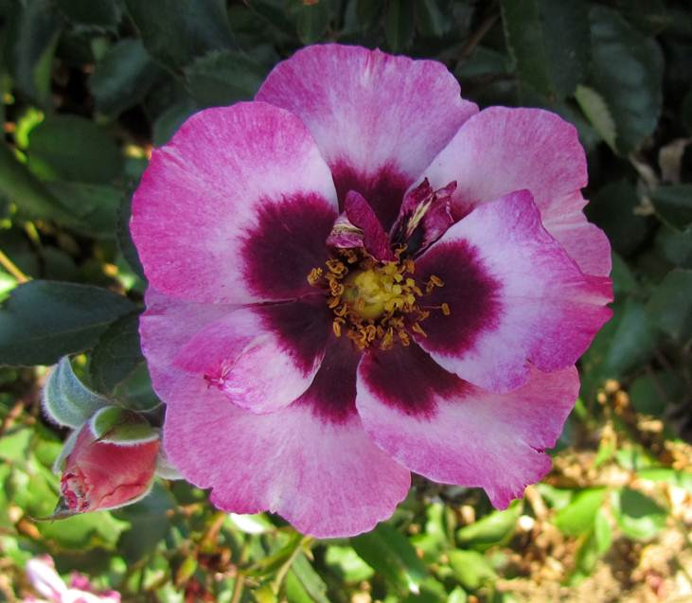
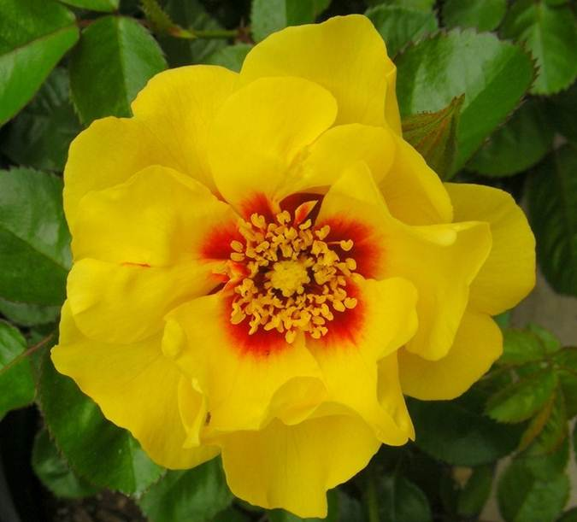
Sproul’s Eyeconic Roses
Melon
Pink Lemonade
Photos
Courtesy of Star Roses
LEMONADE
PINK Pomegranate
Lemonade

Slide 77
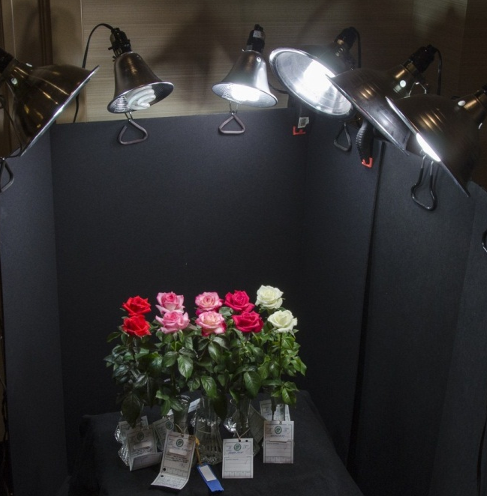
Miniatures
And
Minifloras
ROCK !
Smile for the camera, ladies!
Photo by
Dona Martin

Slide 78
Minis &
Minifloras
JOY

Slide 79
SANDY’S PICK Miniflora by Frank Benardella
Photo by Sandy Lundberg

Slide 80
DR. TOMMY CAIRNS Miniature by Frank Benardella
Photo Courtesy of Bob Martin

Slide 81
PINK FLAMENCO Miniature by Frank Benardella
Notes:
2011 intro. After Frank’s death, PF was sent to Greenheart for evaluation. This dark pink glows in the garden due to the strong reddish pink coloration. Disease resistant. A few available from Whit Wells, For Love of Roses.

Slide 82
MAGIC SHOW Miniature by Frank Benardella
Photo by Dona Martin

Slide 83
PATRON Miniflora by Frank Benardella

Slide 84
BENARDELLA SEEDLINGS
BENbrave
BENStri

Slide 85
The Ears Have IT !

Slide 86
ALYSHEBA Miniature by David Clemons
Photo by Peter Alonso

Slide 87
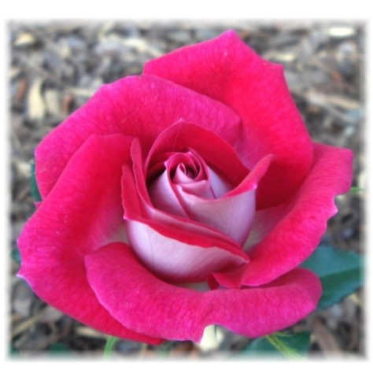
GHOSTZAPPER Miniflora by David Clemons
Photos by Clemons and Rosemania

Slide 88
CLEMONS’ SEEDLINGS
2-05-20
4-06-1

Slide 89
CLEMONS’ SEEDLINGS
12-10-04
22-07-01

Slide 90
Clemons’ Seedlings
30-06-01
30-03-3

Slide 91
KLASSY LADY Miniature by Diane Klassy
Sport of
Ms Flippins
Photo by Peter Alonso

Slide 92
The Peggy Martin Rose aka “Katrina Rose”

Slide 93
MANUEL CUEVAS Miniflora by Whit Wells
Photo courtesy of ForLoveOfRoses.com

Slide 94
THE STREAK Miniature by Whit Wells
Photo courtesy of ForLoveOfRoses.com

Slide 95
“NOT FIRST CHOICE” Miniflora by Whit Wells
Photo courtesy of ForLoveOfRoses.com

Slide 96
PAULA SMART (aka Smart N Sassy)
Miniflora
By Brad Jalbert
Photo by Brad Jalbert

Slide 97
MELANIE DOWE Miniflora by Brad Jalbert
Photo by Brad Jalbert

Slide 98
VUCKO SIMIC Miniflora by Brad Jalbert
Photo by Brad Jalbert

Slide 99
LITTLE MUFF Miniature by Colin Horner
Photo by Steve Singer

Slide 100
THE LIGHTHOUSE Miniature by Jim Sproul
Photo by Kitty Belendez

Slide 101
GINNY Sport of Jean Kenneally by Gary Whitt
Photo from Sandy Lundberg

Slide 102
COOPER Miniflora by Michael Williams

Slide 103
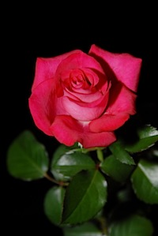
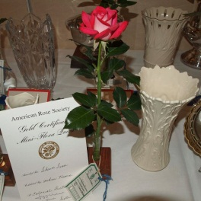
SHAWN SEASE Miniflora by Michael Williams

Slide 104
Arkansas’ shade in 105º…

Slide 105
QUEEN OF HOPE Miniflora by Fred Wright
Photo by Fred Wright

Slide 106
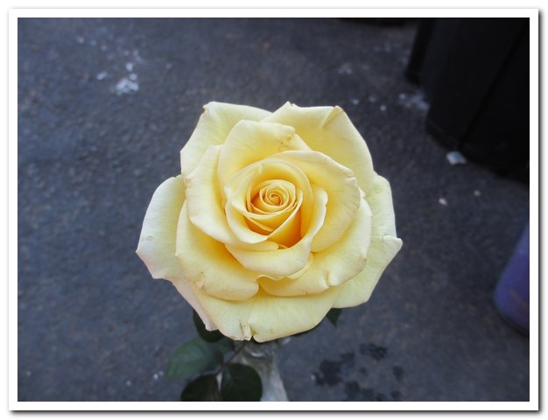
GIFT OF LOVE Miniflora by Fred Wright
Photo by Fred Wright

Slide 107
CRYSTAL PALACE
Miniflora by
Fred Wright
Photo by Sandy Lundberg

Slide 108
WRIGHT TOUCH Miniflora by Fred Wright
Photo by Fred Wright

Slide 109
SHOWTIME Miniflora by Fred Wright
Photo by Fred Wright

Slide 110
MARY ALICE
Miniflora
By Fred Wright
Photo by Fred Wright

Slide 111
GLOWING SUNSET
Miniflora by
Fred Wright
Photo by Carol Shockley

Slide 112
PRINCESS KATELYN Miniflora by Fred Wright
Photo by Fred Wright

Slide 113
VERNON’S DREAM Miniflora by Fred Wright
Photo by Fred Wright

Slide 114
WRIGHT’S SEEDLING MINIFLORA
Photo by Fred Wright

Slide 115
SANDUSKY Miniature by Glenn Smith, Jr.
Photo Courtesy of ForLoveOfRoses.com

Slide 116
WANDERLUST Miniature by Glenn Smith, Jr.
Photo Courtesy of ForLoveOfRoses.com

Slide 117
SEATTLE SUNRISE
Miniflora
By Mitchie Moe
Photo by Dona Martin

Slide 118
INTIMIDATOR Miniature by Vernon Rickard
Photo by Sandy Lundberg

Slide 119
ETERNITY
Miniflora
by Vernon Rickard
Photo courtesy of
ForLoveOfRoses.com

Slide 120
LITTLE RED BRITCHES Miniature by Paula Adlong
Photo by Carol Shockley

Slide 121
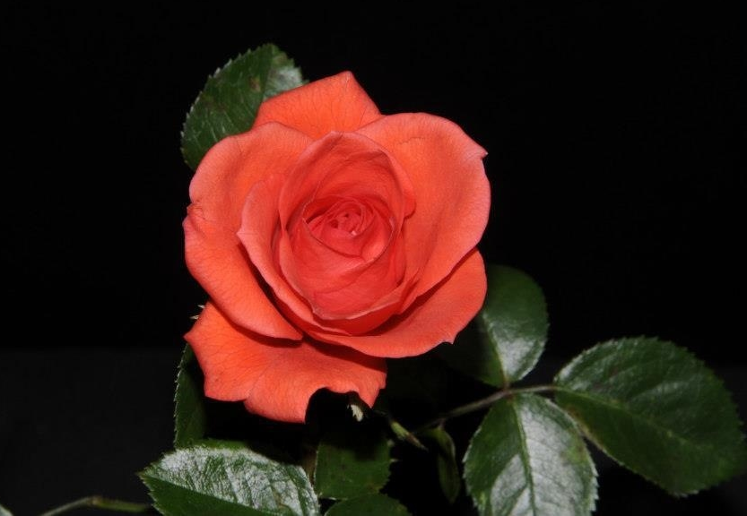
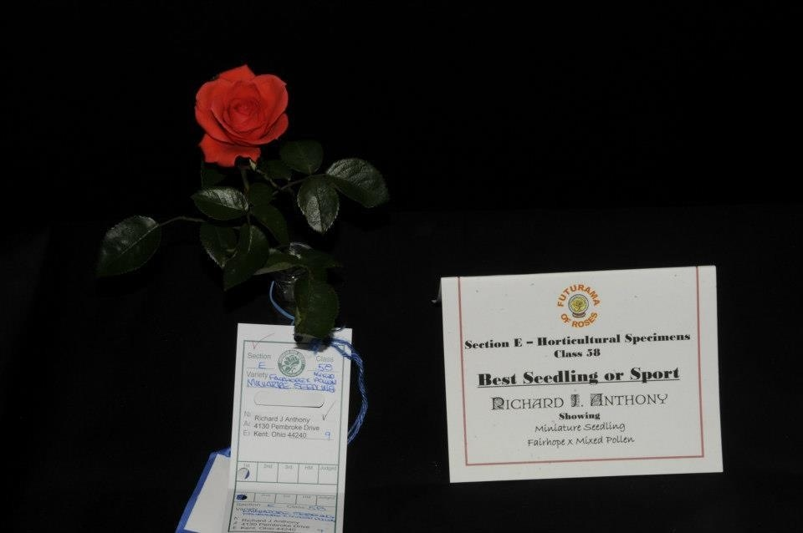
RICHARD ANTHONY’S MINIATURE SEEDLING
Photo by Richard Anthony

Slide 122
Robbie Tucker…can’t wait for your new creations!

Slide 123
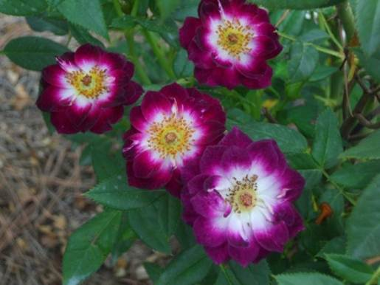
Diamond Eyes Miniature by Tom Carruth
Weeks Roses Photo
Photo by Kathy Strong

Slide 124
Hello, Gorgeous!
Miniature
by Chris Greenwood

Slide 125
THE GOVERNATOR
Miniature by
Chris Greenwood
Photo Courtesy of ForLove
OfRoses.com

Slide 126
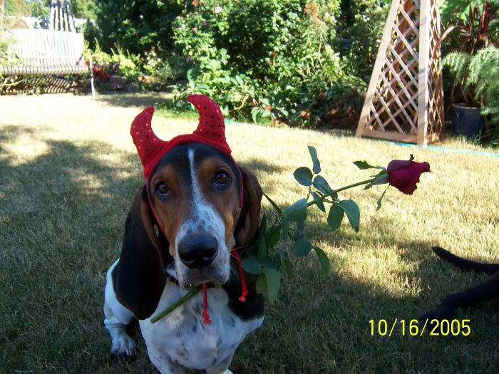
Adios from
The Rose Devil…

Slide 127
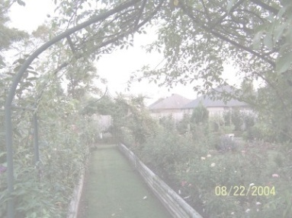
MANY THANKS to Fred Wright, Tommy Hebert, Bob Martin, Steve Singer, Larry Meyer, Sandy Lundberg, John Smith, and Brad Jalbert for sharing their thoughts and pictures. You are the best!
Carol

Slide 128
SOURCES: HORIZON ROSES
AND AMERICAN ROSE EXHIBITORS’ SOCIETY
WRIGHT’S SISTER RUBY

