Slide 1
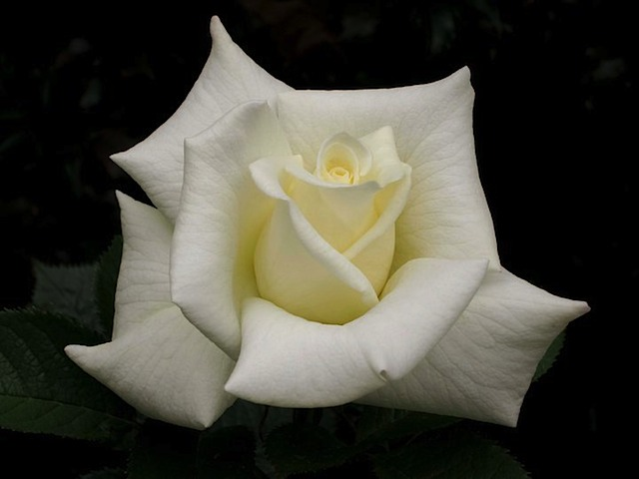
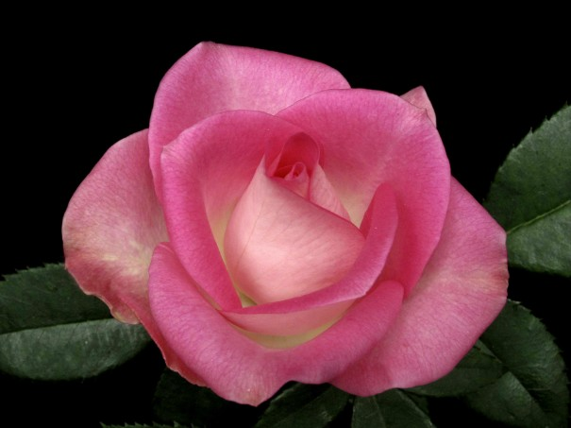
CHOICE ROSES FOR 2012: Latest and Classic
FindingRoyalty
~
Exhibition Roses
South Central District
Winter Workshop
Carol Shockley
Central Arkansas Rose Society
March 1, 2014

Slide 2
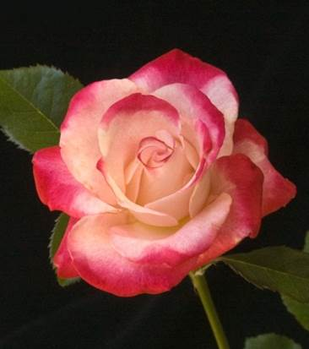
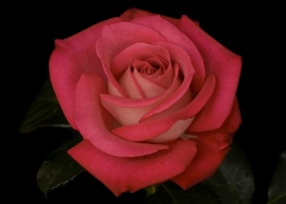
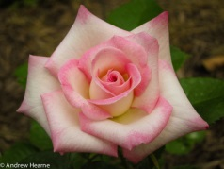
ROSES ON THE HORIZON
Background photo by American Astronaut Whitlock

Slide 3
Lights, Camera, Action…
Hybrid Teas at their best!
Photo by Dona Martin

Slide 4
MARLON’S DAY Hybrid Tea by Fred Wright
Photo by Sandy Lundberg

Slide 5
BROTHER HUGH Hybrid Tea by Fred Wright
Photo by Fred Wright

Slide 6
DAVID’S LOVE
Hybrid Tea by
Fred Wright
Photo by Fred Wright

Slide 7
SWEET ANGEL Hybrid Tea by Fred Wright
Photo by Fred Wright

Slide 8
SWEET MARLON Hybrid Tea by Fred Wright
Photo by Fred Wright

Slide 9
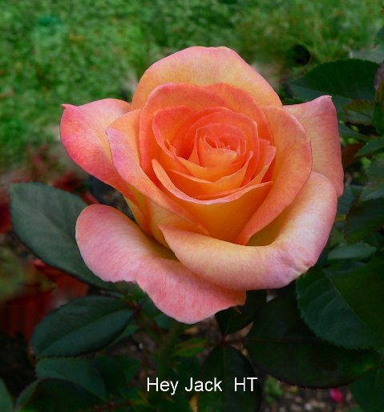
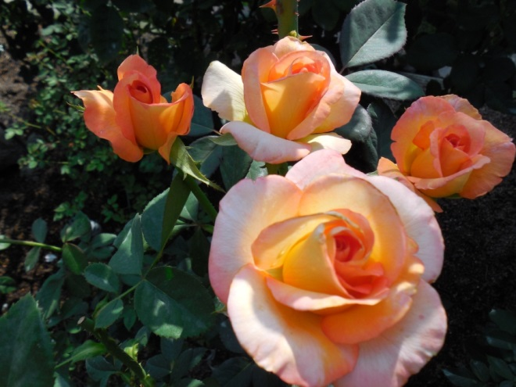
Hey Jack
Hybrid Tea by Fred Wright
Photo by
Larry Meyer
Photo by Carol Shockley

Slide 10
GEMINI’S CHARM Hybrid Tea by Fred Wright
Photo by Fred Wright

Slide 11
MOM AND POP WRIGHT Hybrid Tea by Fred Wright
Photo by Fred Wright

Slide 12
MAGNIFICENCE Hybrid Tea by Fred Wright
Photo by Fred Wright

Slide 13
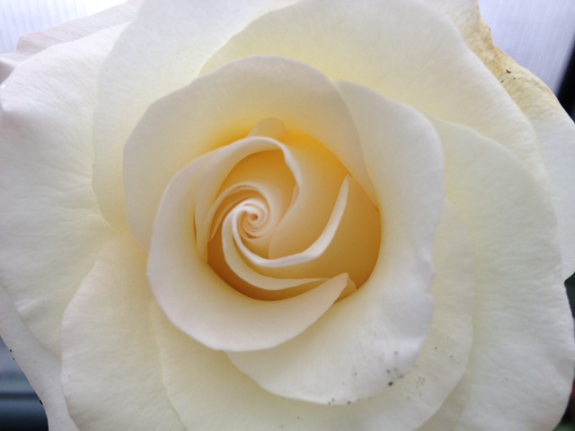
DONNA’S GRACE
Hybrid Tea by Fred Wright
Shockley Photo
Photo by
Fred Wright

Slide 14
BOLD AND BEAUTIFUL Hybrid Tea by Fred Wright
Photos by Larry Meyer

Slide 15
MY MARY ANN Hybrid Tea by Fred Wright
Photo by Fred Wright

Slide 16
SUNDAY EVENING Hybrid Tea by Fred Wright
Photo by Larry Meyer

Slide 17
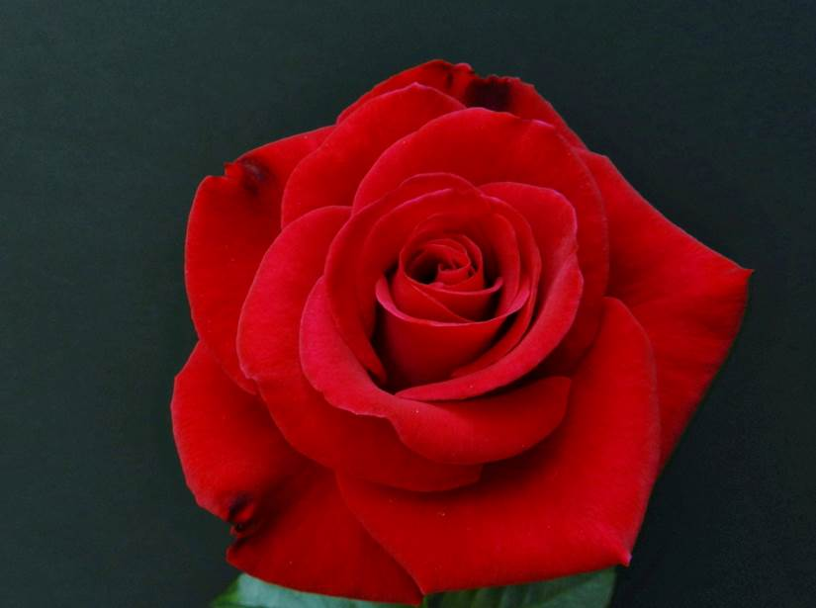
MR. CALEB Hybrid Tea by Fred Wright
Photo by Larry Meyer
Photo by Cindy Dale

Slide 18
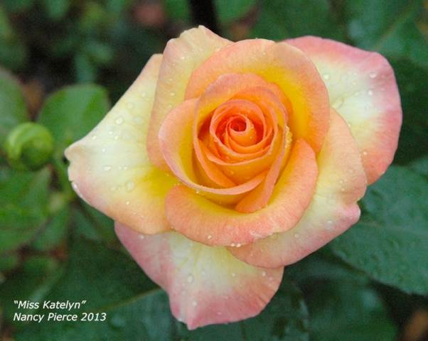
MISS KATELYN Hybrid Tea by Fred Wright
Photo by Nancy Pierce
Photo by Fred Wright

Slide 19
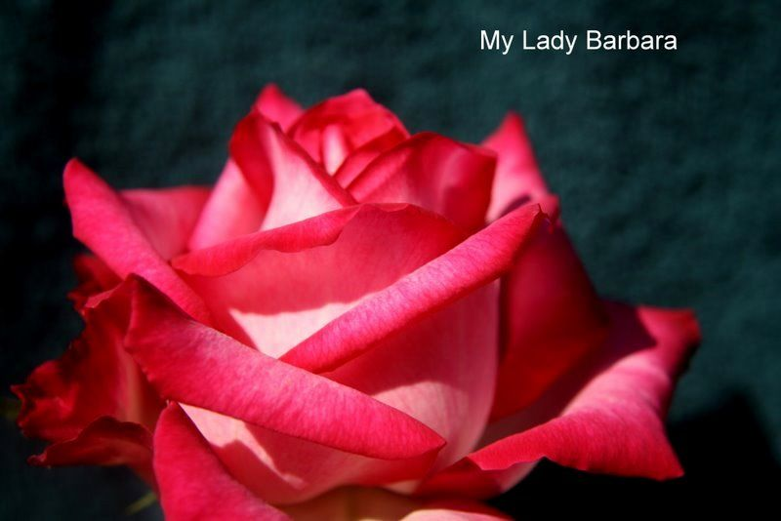
MY LADY BARBARA Hybrid Tea by Fred Wright
Photos by Fred Wright & Dona Martin

Slide 20
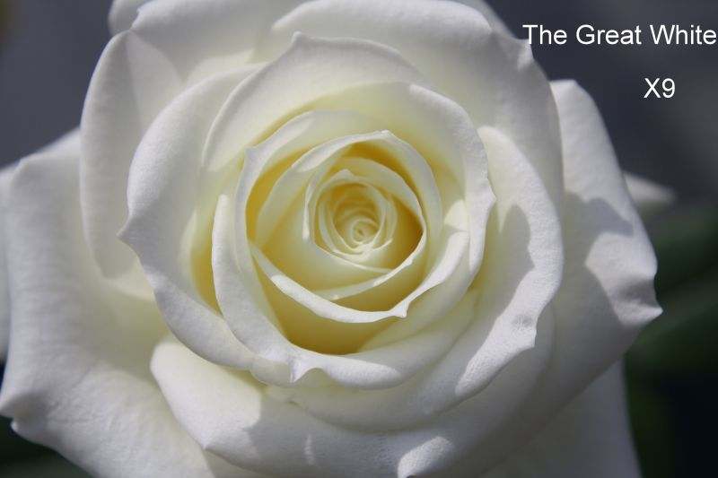
THE GREAT WHITE Hybrid Tea by Fred Wright
Photos by Fred Wright &
Larry Meyer

Slide 21
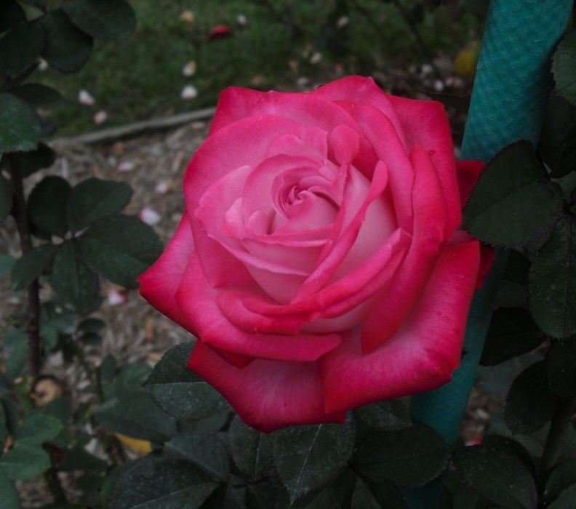
DAISY LOUISE Hybrid Tea by Fred Wright
Photos by Fred Wright
and Sandy Lundberg

Slide 22
BROTHER JACK Hybrid Tea by Fred Wright
Photo by Larry Meyer

Slide 23
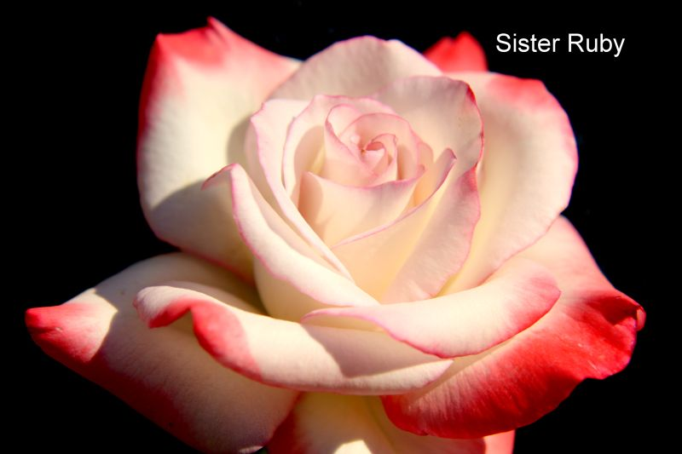
SISTER RUBY Hybrid Tea by Fred Wright
Photos by
Fred Wright and
Larry Meyer
Notes:
And here’s another of my favorites (I say that a lot)…SISTER RUBY. Grew very well and had exceptional form. Beautiful colors. NICE.

Slide 24
Fred Wright’s Hybrid Teas
Carolina Pride
Phillip’s Grand Slam
Photos by Larry Meyer
Notes:
I haven’t grown either of these. Fred says Hey Jack “will win cycles of bloom and lots of queens”. Most colorful of all his roses. Phillip’s looks good; superior form. Named for baseball playing grandson. Per Fed could be better than Mr. Caleb.

Slide 25
EDDIE EDWARDS Hybrid Tea by Fred Wright
Photo Courtesy of Fred Wright
Notes:
Heard that Eddie was naming a rose for himself but Fred beat him to the punch. Lots of petals. It should be good. K&M this year.

Slide 26
Hybrid Teas by Fred Wright
SISTER JANE
LOVING YOU
Fred Wright Photo
Shockley Photo
Notes:
Sister Jane is pink and yellow. Has excellent form and color. It did very well but my vote was for the other sister. Sister Ruby. Loving You is a beautiful ruffled ivory rose with good centers and size. It holds forever. Short bush in comparison to Fred’s other roses.

Slide 27
MS. JAN Hybrid Tea
Photo Courtesy of Fred Wright
Notes:
Looks wildly ruffledbut I’m going to try it. Maybe it just had a bad hair day! I’ll let you know more about it. K&M this year.

Slide 28
TOP GUN Hybrid Tea By Fred Wright
Photo Courtesy of Fred Wright
Notes:
Fred says this one has it all—color, form and size and to look for queens from it. The Top Gun club voted to name this rose..TOP GUN.

Slide 29
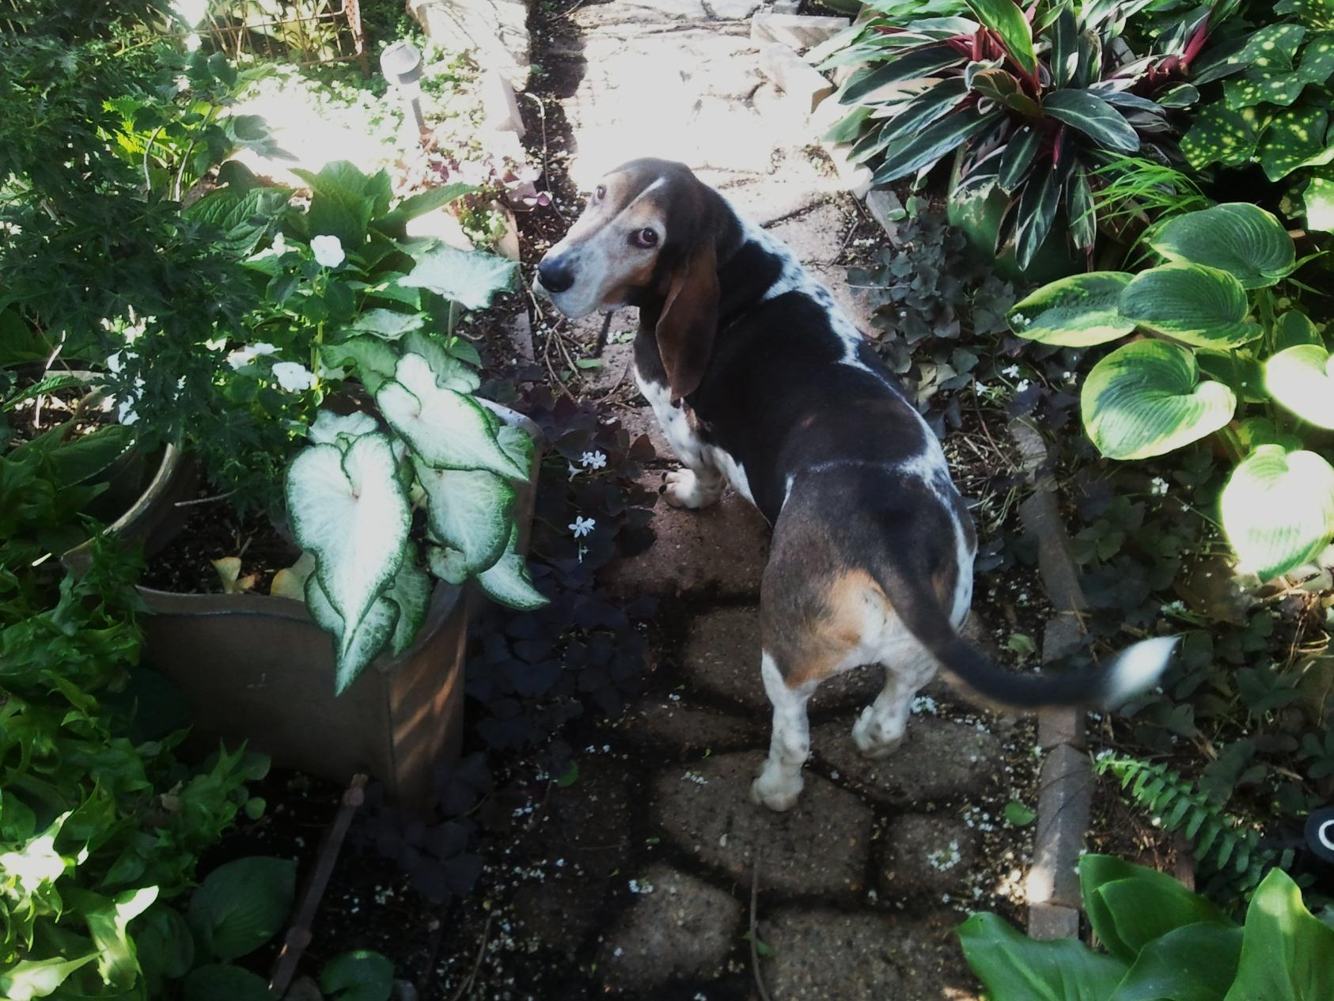
Let’s go see what’s blooming!

Slide 30
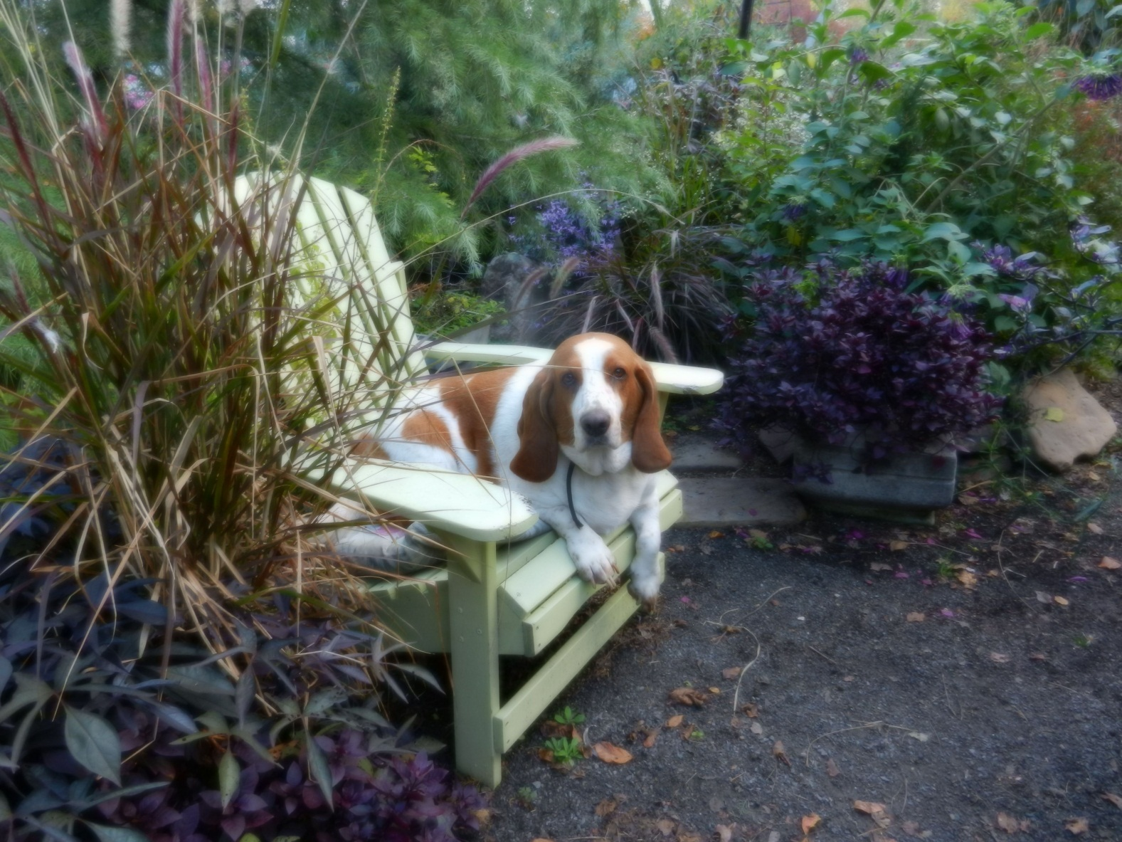
Or…just sit down and rest a spell…

Slide 31
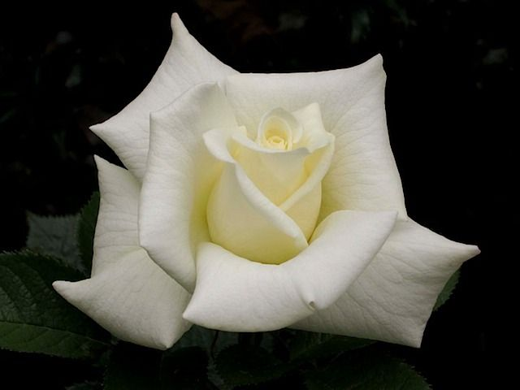
RANDY SCOTT Hybrid Tea HT by John Smith
Photos by Larry Meyer
&
Andrew Hearne

Slide 32
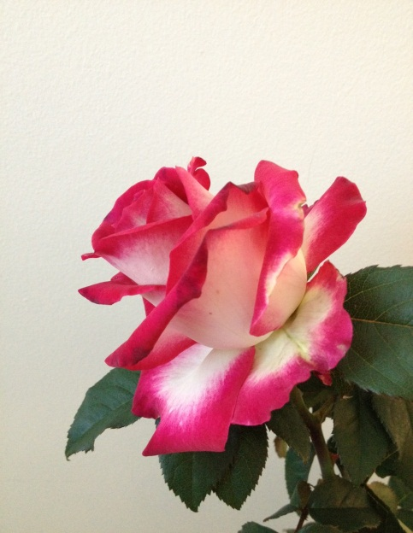
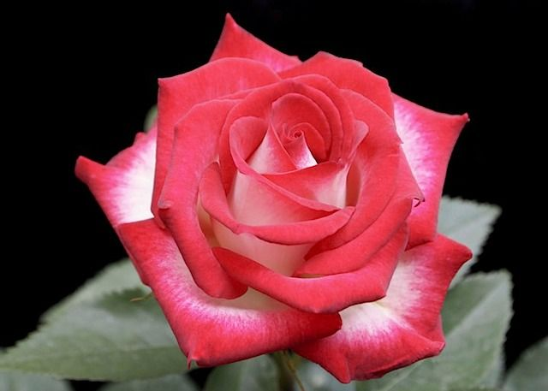
DINA GEE Hybrid Tea by John Smith
Shockley Photo
Andrew Hearne Photo

Slide 33
SNUFFY
Hybrid Tea
By John Smith
Photo by Dona Martin

Slide 34
SUNNY SUNDAYS Hybrid Tea by John Smith
Photo by Andrew Hearne

Slide 35
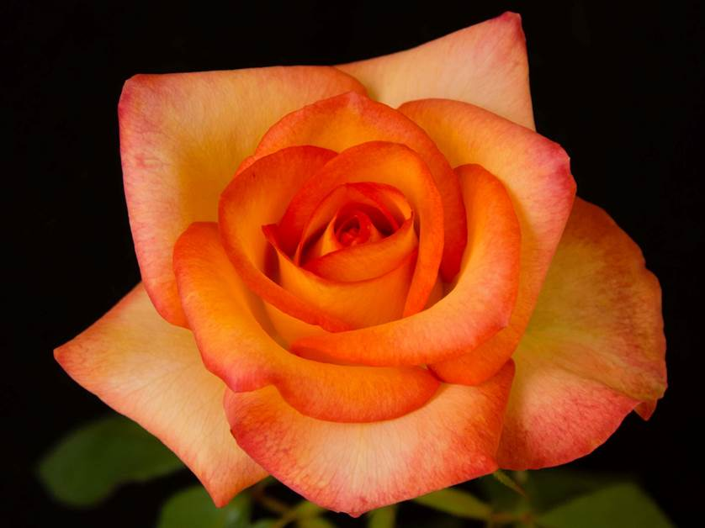
A few more… SUNNY SUNDAYS
Photos by
John Smith
Photo by Andrew
Hearne

Slide 36
SILVER CREAM Hybrid Tea by John Smith
Picture by John Smith

Slide 37
BABIES BLUSH Hybrid Tea by John Smith
Photo by Andrew Hearne

Slide 38
John Smith’s Hybrid Tea Seedling
Photo by John Smith

Slide 39
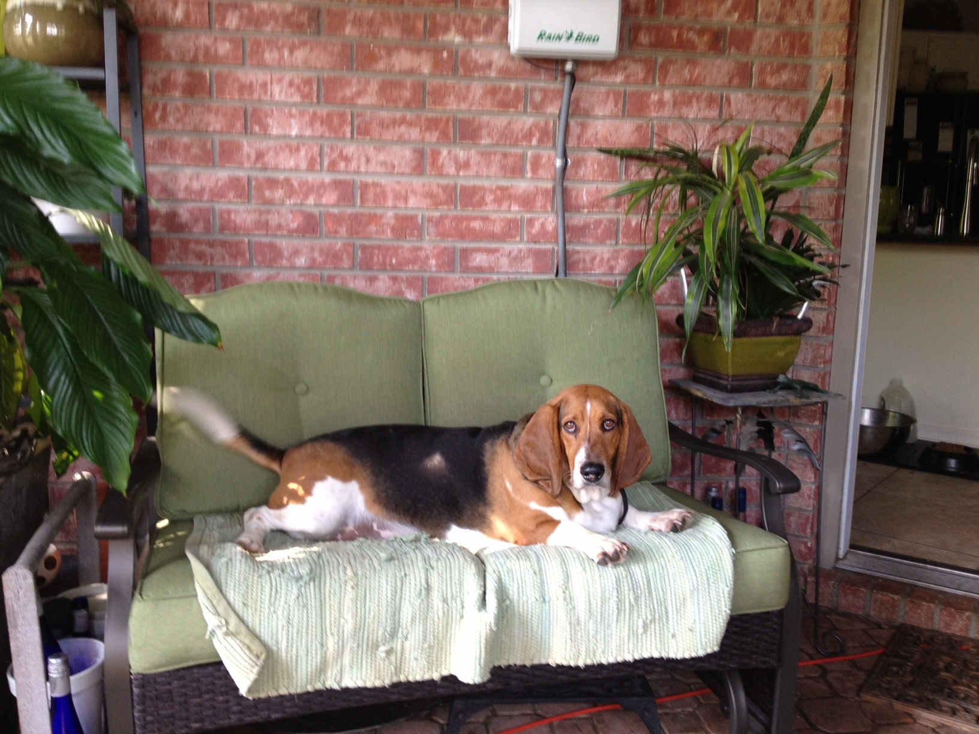
Bradley prefers air conditioning until evening.

Slide 40
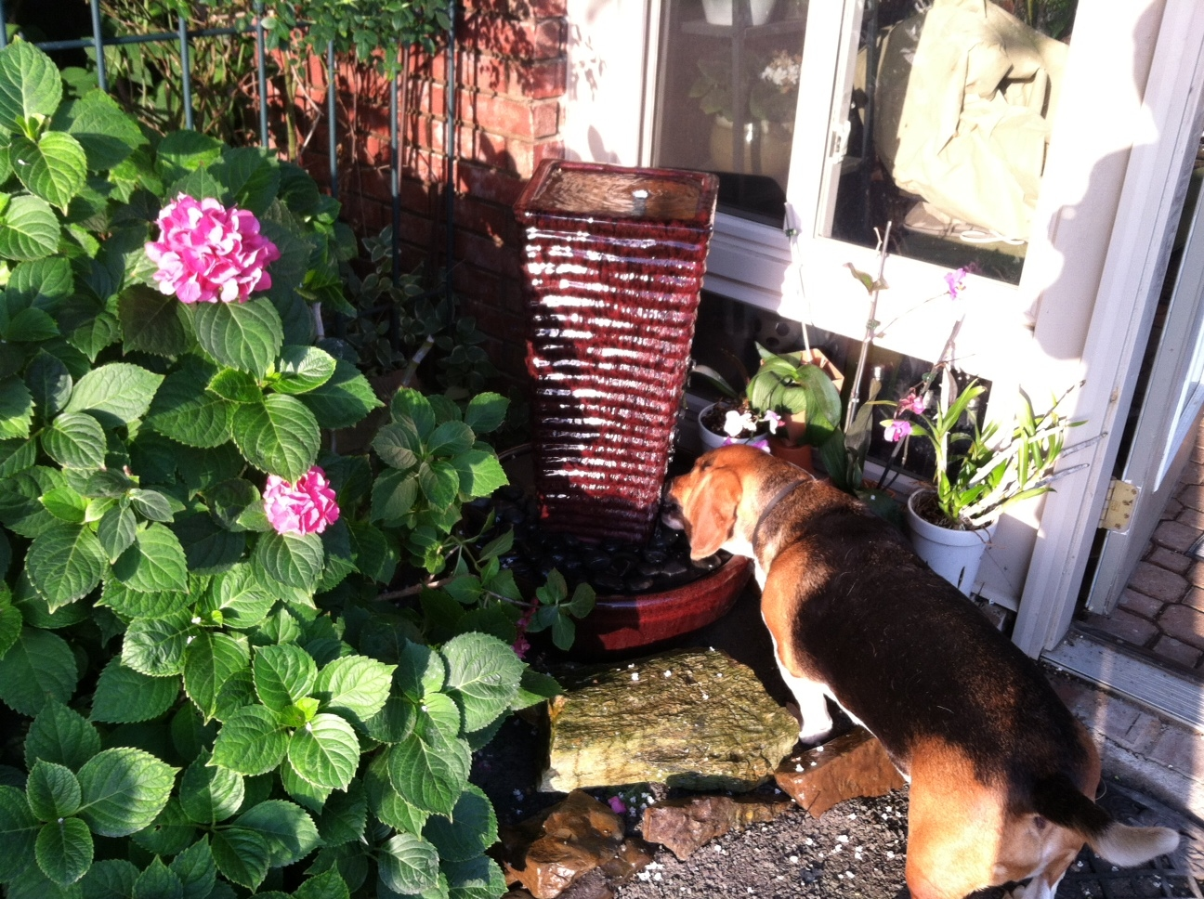
When the water is cool.

Slide 41
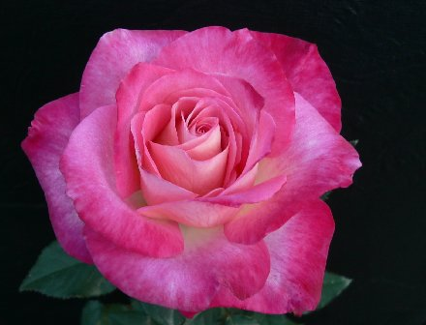
JEWEL GRACE
Hybrid Tea by Eddie Edwards
Photo by Larry Meyer

Slide 42
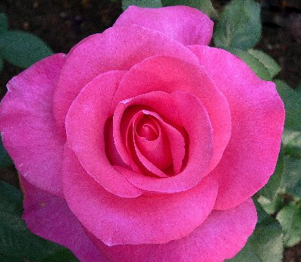
KAREN CONSTANT
Hybrid Tea by Eddie Edwards
Photo by Larry Meyer

Slide 43
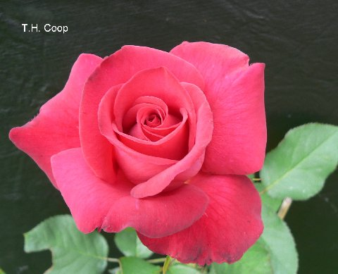
TH COOP
Hybrid Tea by Eddie Edwards
Photo by Larry Meyer

Slide 44
SHUG Hybrid Tea by Tommy Hebert
Photo by Tommy Hebert

Slide 45
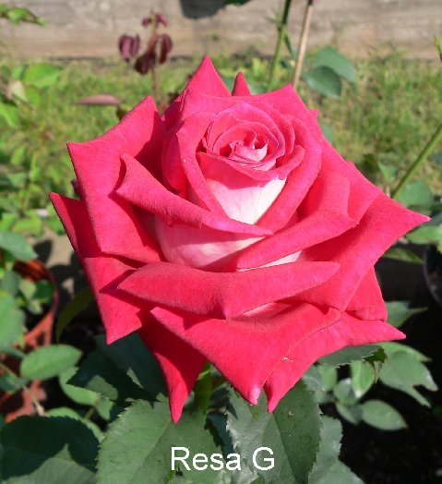
RESA G Hybrid Tea by Tommy Hebert
Photo by Tommy Hebert
Photo by Larry Meyer

Slide 46
MS. TIS Hybrid Tea by Tommy Hebert
Photo by Tommy Hebert

Slide 47
SUPER NOVA Hybrid Tea by Tommy Hebert
Photo by Tommy Hebert

Slide 48
Rosa Borealis by John Mattia

Slide 49
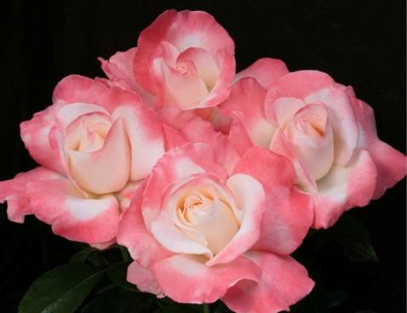
CRESCENDO Hybrid Tea by Keith Zary
J & P photos

Slide 50
LOVE’S KISS
Hybrid Tea
By Keith Zary
J & P Photo

Slide 51
ALWAYS AND FOREVER Hybrid Tea by Keith Zary
Photo by Rich Baer

Slide 52
NEIL DIAMOND Hybrid Tea by Tom Carruth
Photo Courtesy of Weeks Roses

Slide 53
CINNAMON DOLCE Meilland Hybrid Tea
Photo by Dona Martin

Slide 54
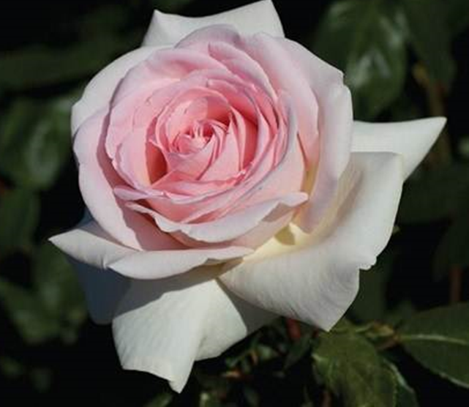
FRANCIS MEILLAND Meilland Hybrid Tea
Final AARS
Rose
Photo Courtesy of Star Roses

Slide 55
MERCURY RISING Meilland Hybrid Tea
Photo Courtesy of Star Roses

Slide 56
DONA MARTIN Sport of Randy Scott
Hybrid Tea
By Bob Martin
Photo by Dona Martin

Slide 57
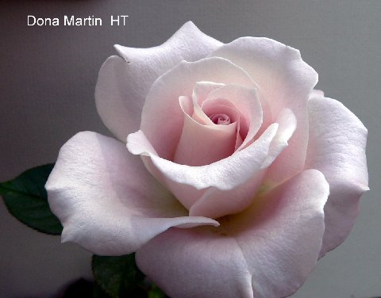
LILAC SURPRISE Bob Martin’s Sport of Dona Martin
Larry Meyer Photo
of Dona Martin
Photo by Bob Martin

Slide 58
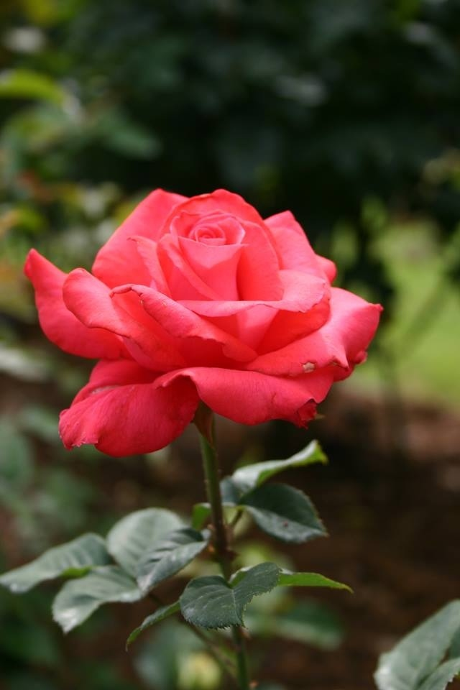
ZACH NOBLES, HT Satish Prabhu’s Sport of Let Freedom Ring
Let Freedom Ring
Photos by Satish
Prabhu

Slide 59
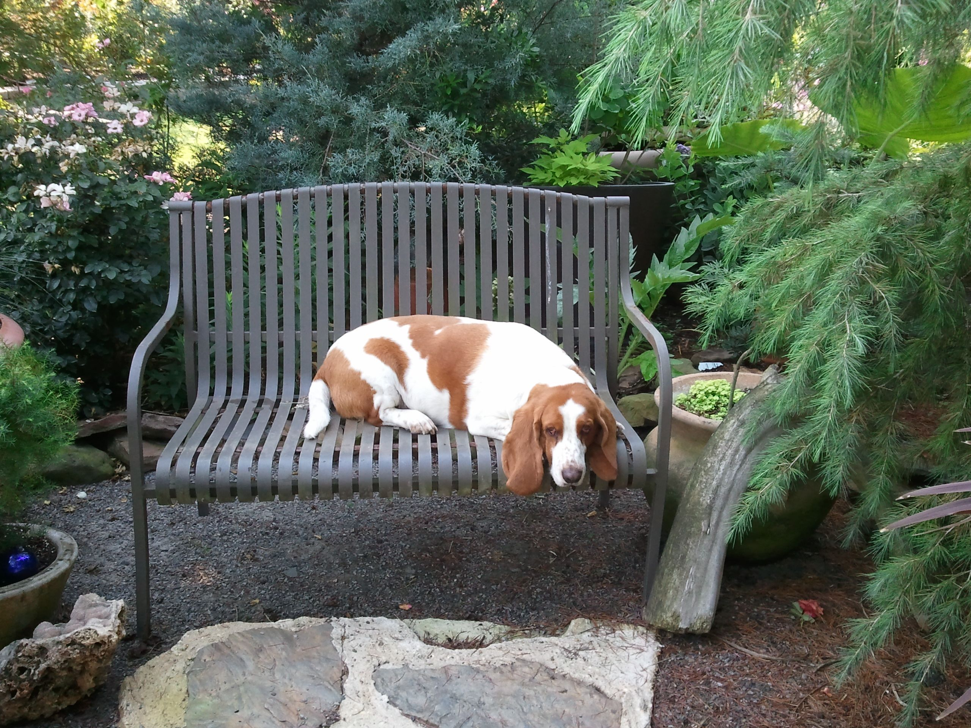
You should hear me howl!

Slide 60
MISS KITTY by Kitty Belendez Hybrid Tea Sport of Cajun Moon
Photo by
Kitty Belendez

Slide 61
CORETTA SCOTT KING Hybrid Tea by Christian Bedard
Weeks Courtesy Photo

Slide 62
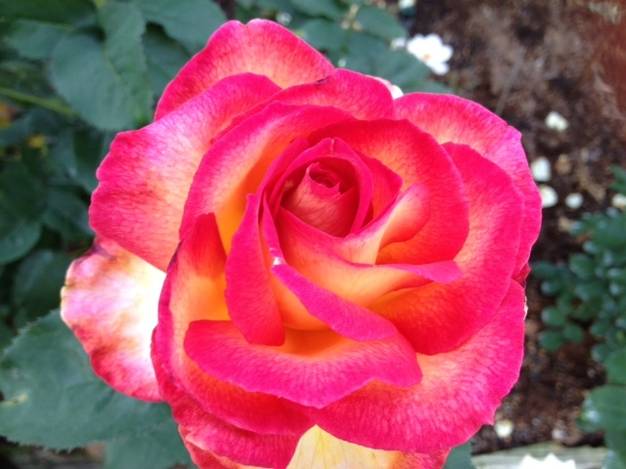
PACIFIC CELEBRATION Hybrid Tea by Frank Strickland
Photo by Sandy Landberg
Photo by Carol Shockley

Slide 63
TANIA NORRIS Hybrid Tea by Luis Desamero
Photo by David Bassani

Slide 64
HOT LADY Hybrid Tea ~ Florist Rose
Photo Courtesy of Steve Singer

Slide 65
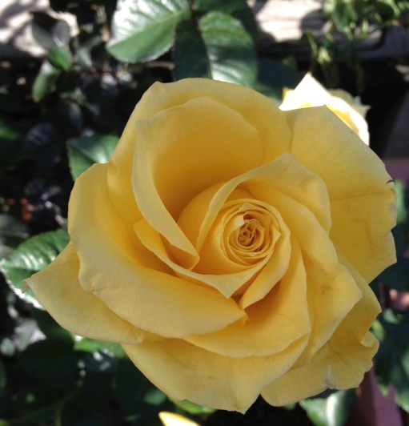
ISABELLE Hybrid Tea Florist Rose
Shockley Photo
Photo by Steve Singer

Slide 66
JULIA’S KISS Hybrid Tea by Lionel Poole
Photo Courtesy of Steve Singer

Slide 67
GIRLS NIGHT OUT Hybrid Tea by Meilland

Slide 68
PAROLE (aka Buxom Beauty)
Hybrid Tea
By Kordes
Photo Courtesy of Steve Singer

Slide 69
GRAND AMORE`
Hybrid Tea by Kordes
Photo by Star Roses

Slide 70
STEPHEN RULO Grandiflora by William Chaney
Photo Courtesy of Steve Singer

Slide 71
HYBRID TEA SEEDLING David Clemons
Photo by David Clemons

Slide 72
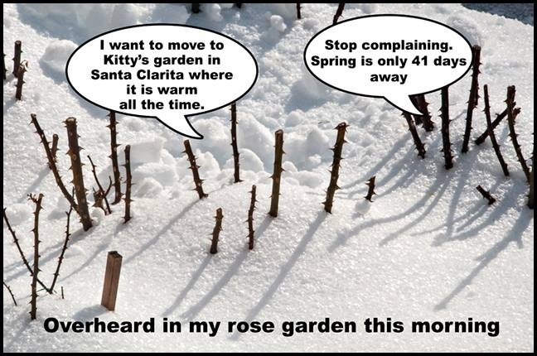
Photo and text by John Mattia

Slide 73
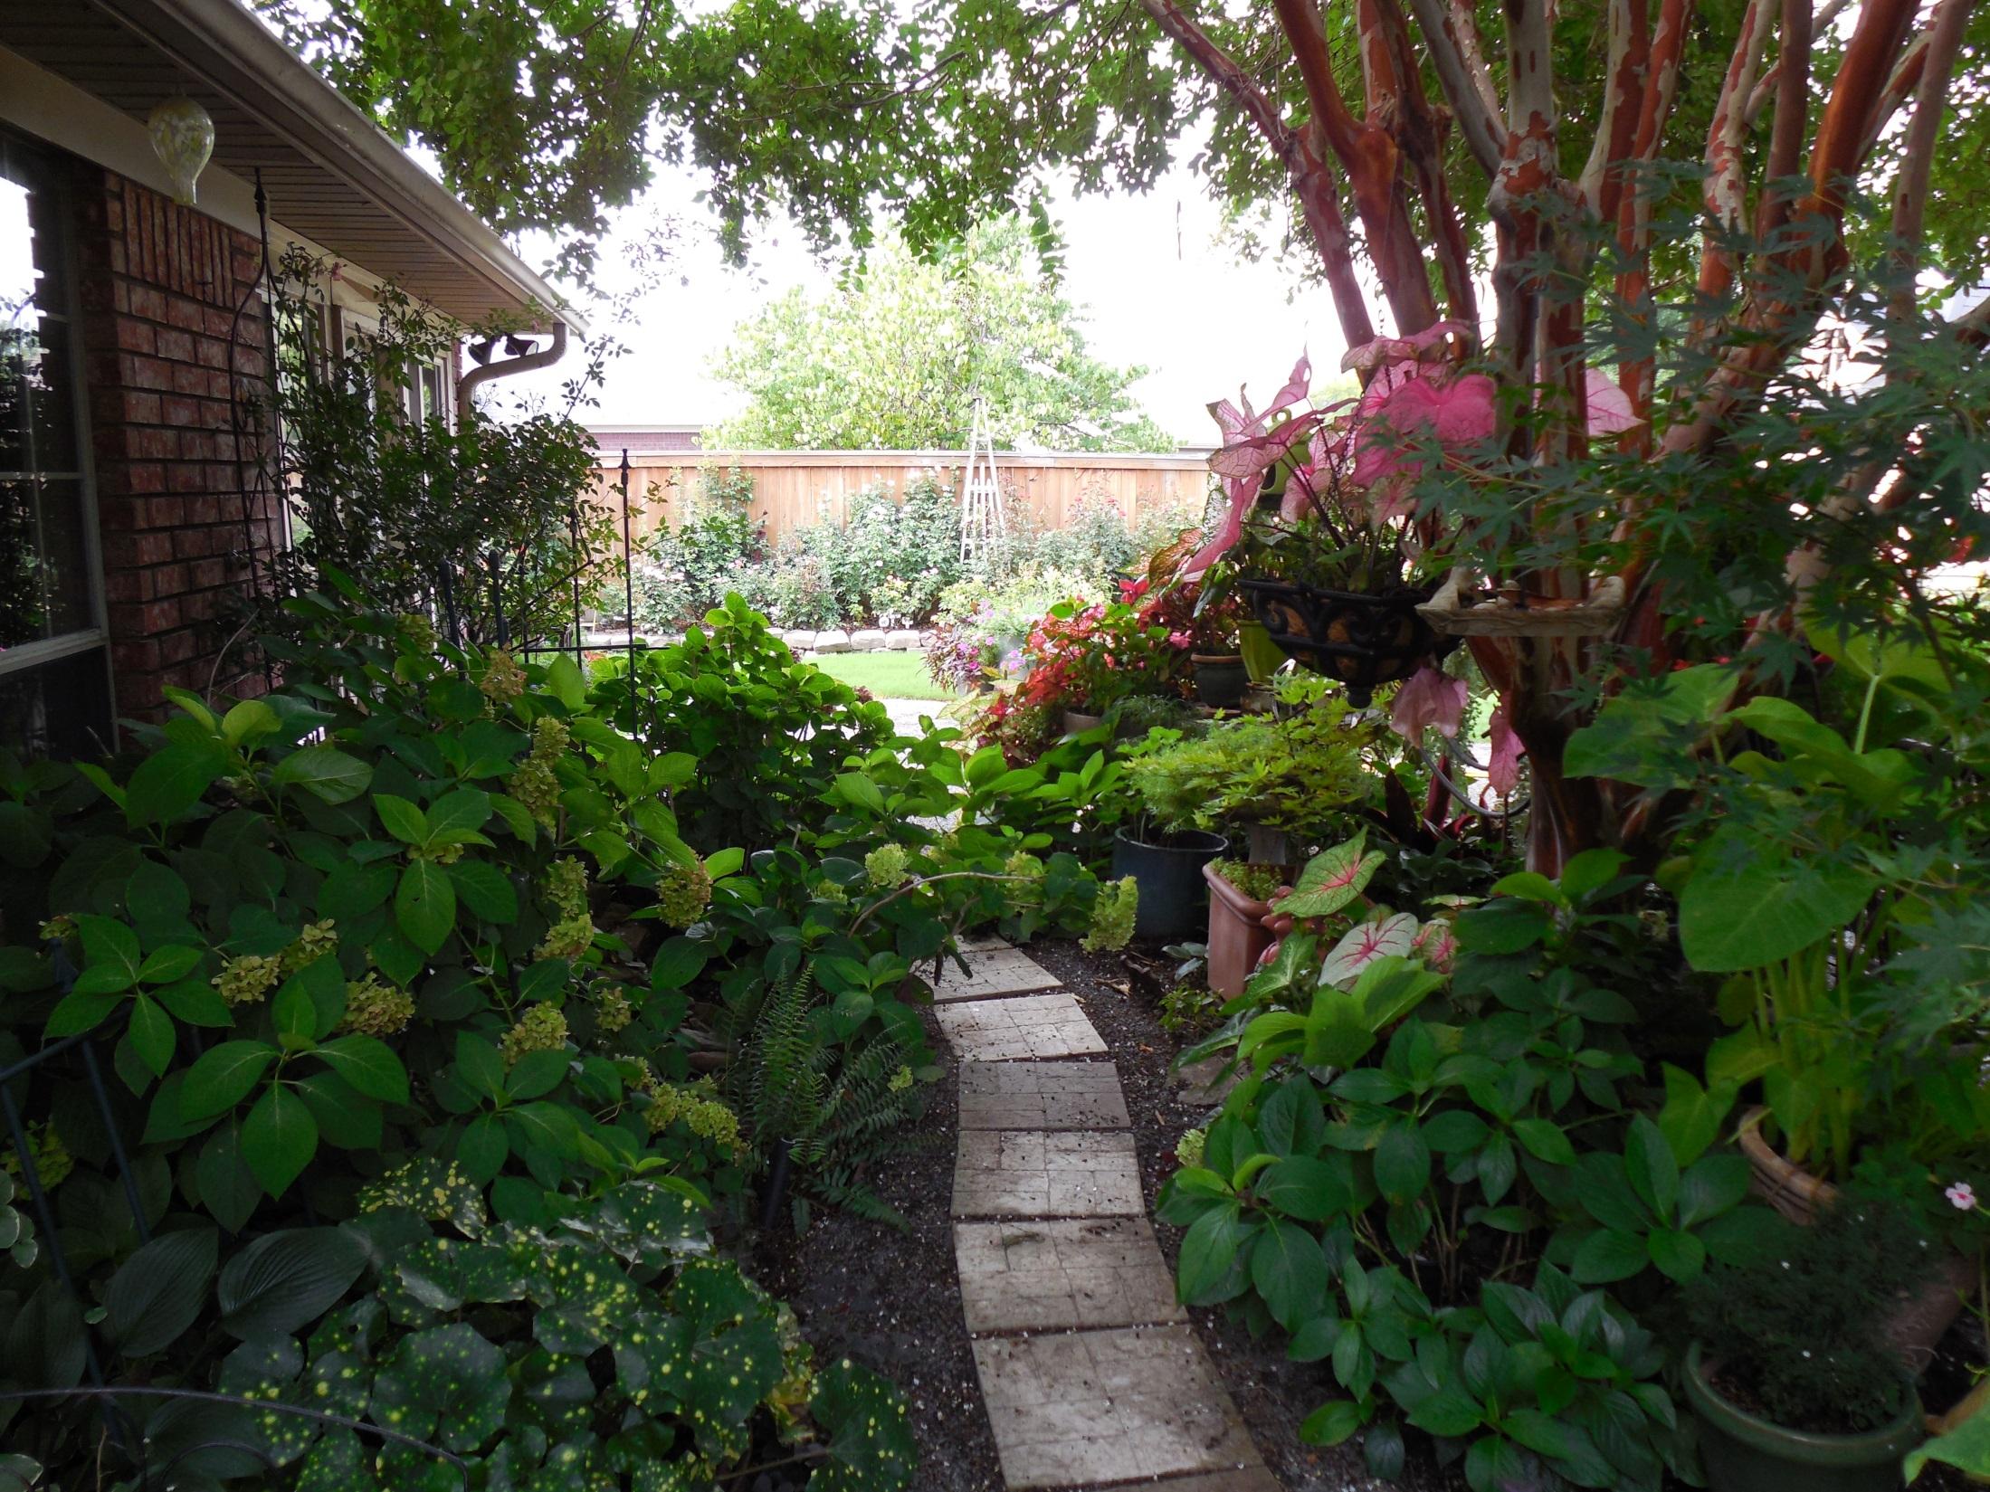

Slide 74
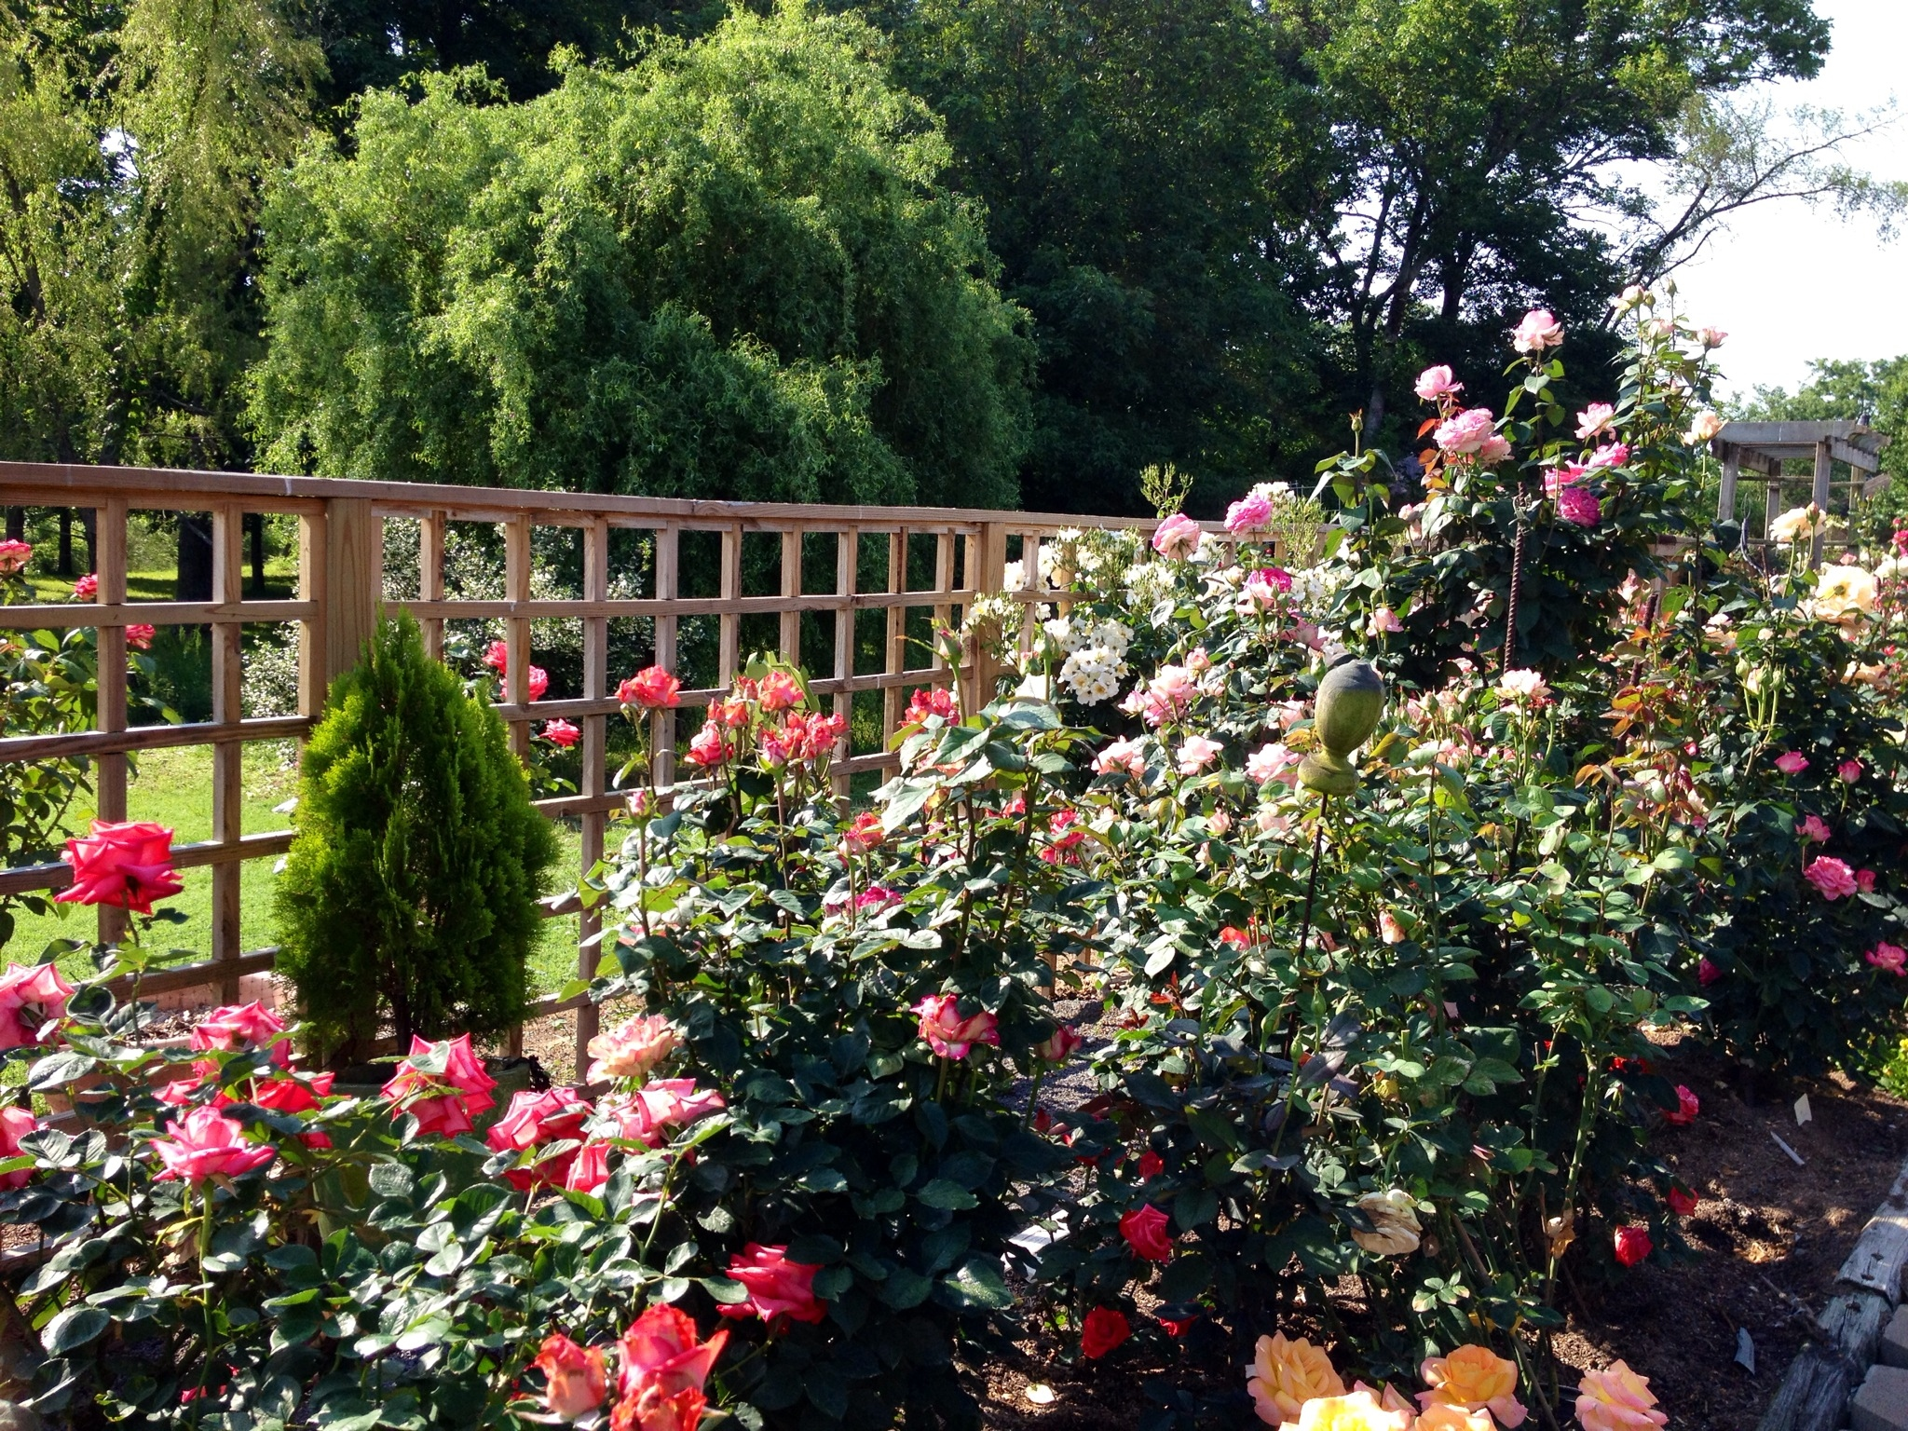

Slide 75
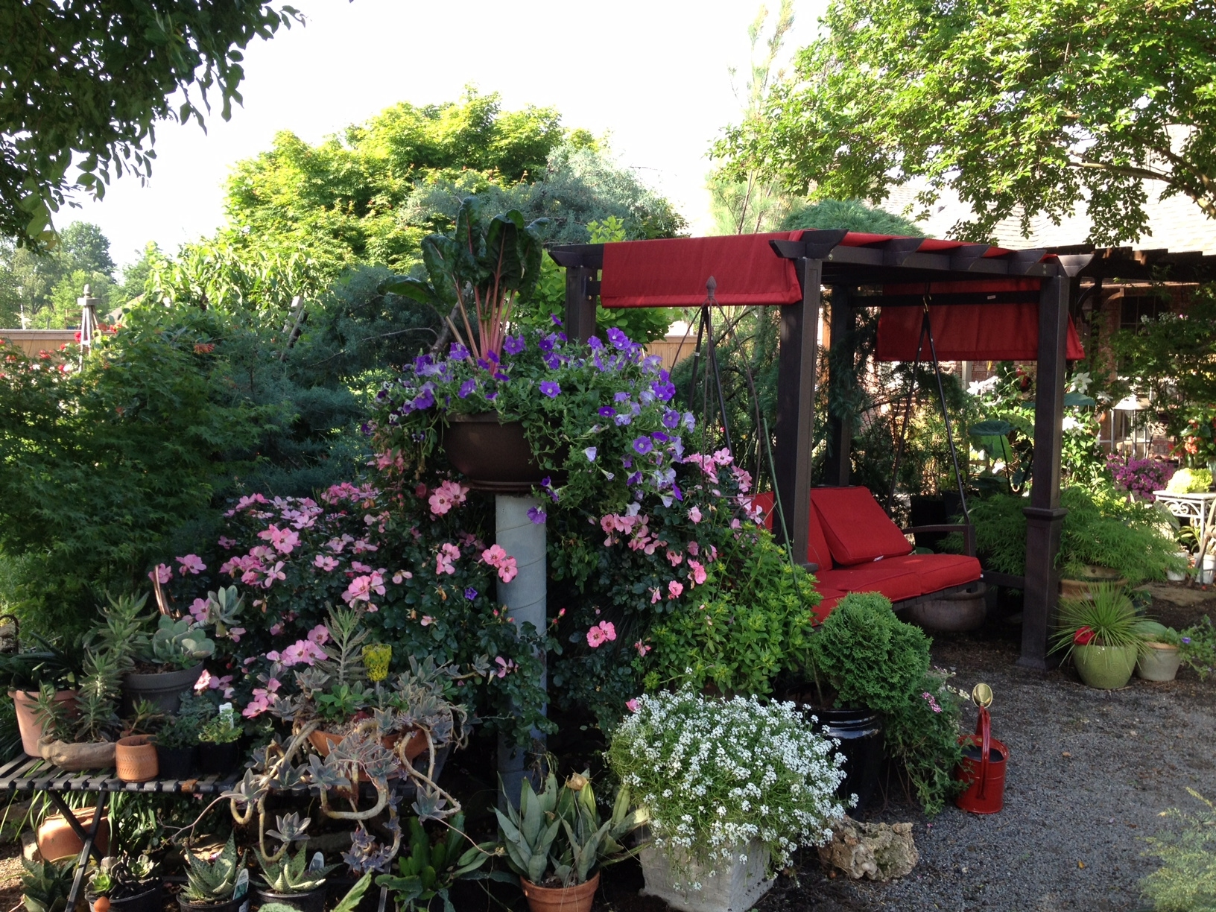
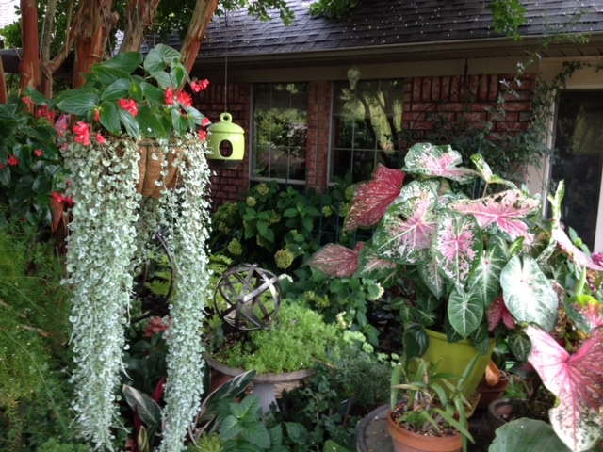

Slide 76
FLORIBUNDAS!

Slide 77
MADISON GRACE Floribunda by Tommy Hebert
Photo by Tommy Hebert

Slide 78
Thelma G Floribunda by Tommy Hebert
Photo by Tommy Hebert

Slide 79
San Diego Sweetheart Floribunda by Frank Strickland
Photo Courtesy of Bob Martin

Slide 80
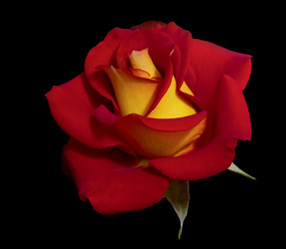
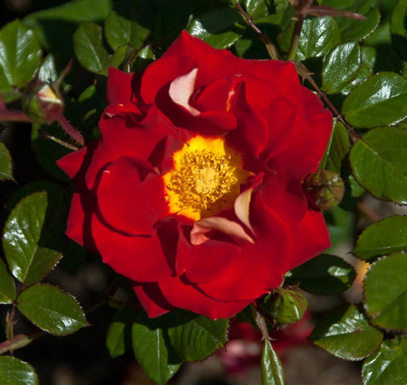
KETCHUP AND MUSTARD
Floribunda by
Christian Bedard
Weeks Roses Photo

Slide 81
OH MY Floribunda by Christian Bedard
Weeks Roses Photo

Slide 82
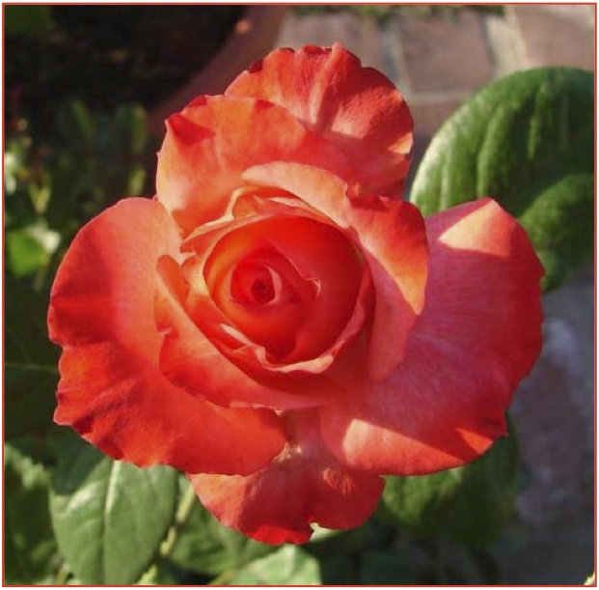
CRISTINA LYNNE by Kitty Belendez Floribunda Sport of Pinnacle
Photos by Kitty Belendez

Slide 83
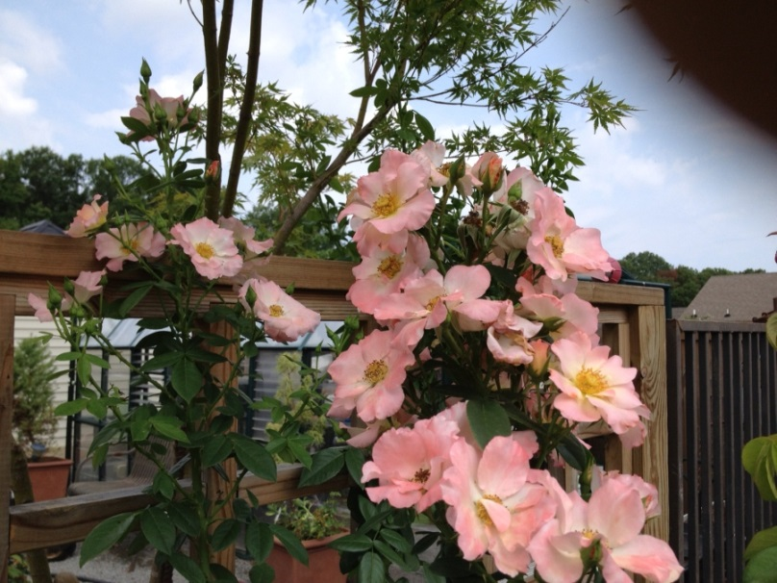
FIFI Floribunda by Henson
Shockley Photo
Photo Courtesy
of Steve Singer

Slide 84
ME & MRS JONES Floribunda by Steve Jones
Photo by Sandy Lundberg

Slide 85
BULLSEYE Shrub by Peter James
Weeks Roses Photo

Slide 86
JOLENE ADAMS Floribunda by James Sproul
Photo by James Sproul

Slide 87
CHOOSE LIFE Floribunda by James Sproul
Photo by James Sproul

Slide 88
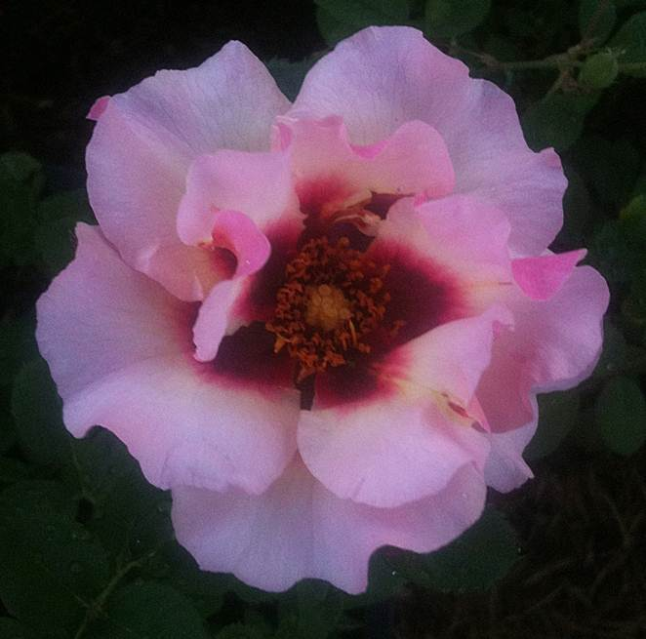
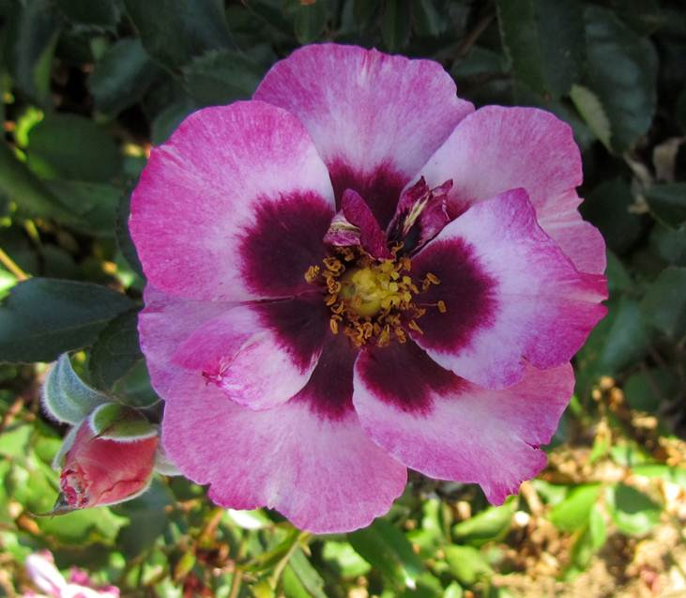
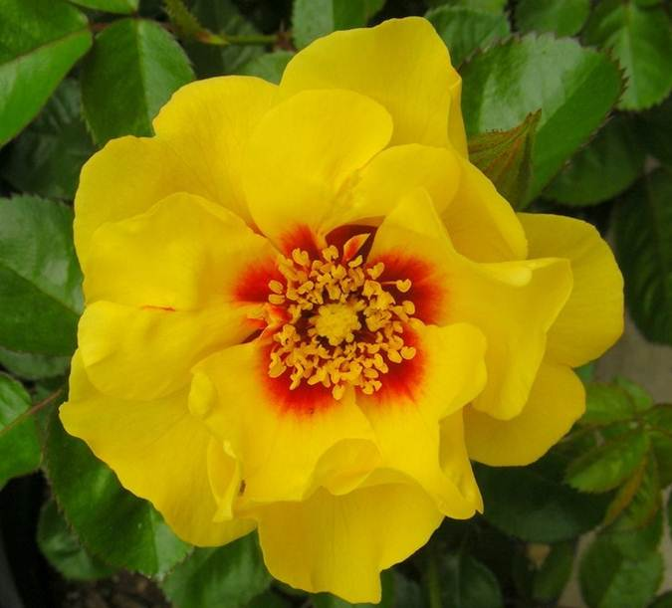
Sproul’s Eyeconic Roses
Melon
Pink Lemonade
Photos
Courtesy of Star Roses
LEMONADE
PINK Pomegranate
Lemonade

Slide 89
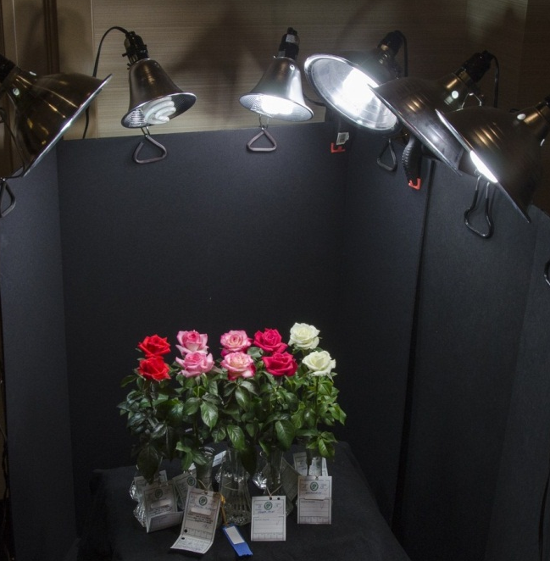
Miniatures
And
Minifloras
ROCK !
Smile for the camera, ladies!
Photo by
Dona Martin

Slide 90
Minis &
Minifloras
JOY

Slide 91
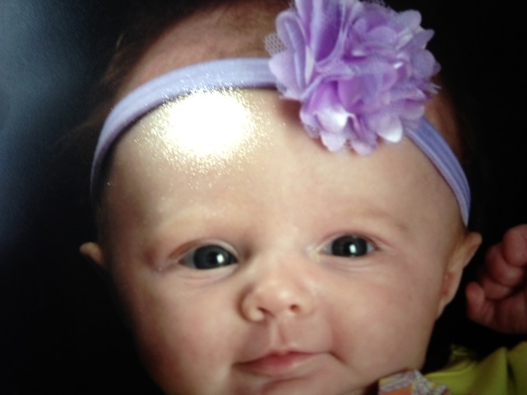
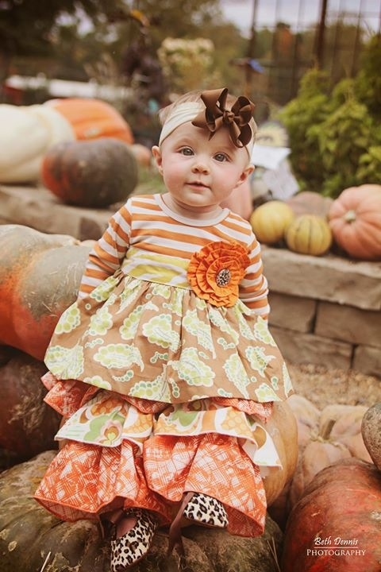
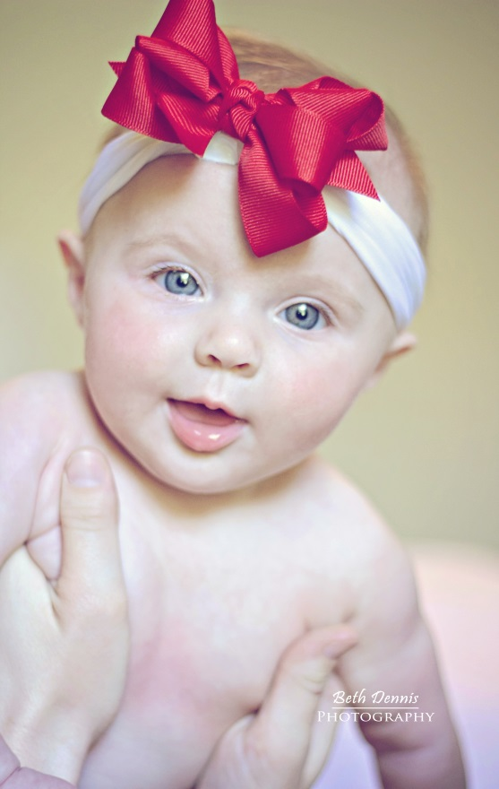
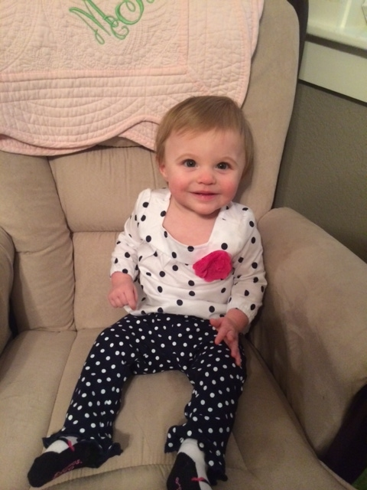
2013
Madison
Anne
Shockley

Slide 92
SANDY’S PICK Miniflora by Frank Benardella
Photo by Sandy Lundberg

Slide 93
DR. TOMMY CAIRNS Miniature by Frank Benardella
Bob Martin Photo
Tom Mayhew Photo
Andrew Hearne
Photo

Slide 94
PINK FLAMENCO Miniature by Frank Benardella
Photo Courtesy of Greenheart
Notes:
2011 intro. After Frank’s death, PF was sent to Greenheart for evaluation. This dark pink glows in the garden due to the strong reddish pink coloration. Disease resistant. A few available from Whit Wells, For Love of Roses.

Slide 95
MAGIC SHOW Miniature by Frank Benardella
Photo by Dona Martin

Slide 96
PATRON Miniflora by Frank Benardella
Photo courtesy of Bob Martin

Slide 97
SHOWSTOPPER Miniflora by Frank Benardella
Ivor Mace Photo

Slide 98
BENARDELLA SEEDLINGS
BENbrave
BENStri

Slide 99
ALYSHEBA Miniature by David Clemons
Photo by Peter Alonso

Slide 100
GHOSTZAPPER Miniflora by David Clemons
Photo by Andrew Hearne
Photo by Clemons

Slide 101
TAMMY CLEMONS Miniflora by David Clemons
2013
‘AOE’ Winner
Photo by Andrew Hearne

Slide 102
TAMMY CLEMONS
Miniflora by David Clemons
2013
AOE
Clemons and
Hearne Photos

Slide 103
CLEMONS’ SEEDLINGS
2-05-20
4-06-1

Slide 104
DAVID CLEMONS MINIFLORAS
WHIRLAWAY
UNBRIDLED
Andrew Hearne Photos

Slide 105
JOY
BY DAVID CLEMONS

Slide 106
COCONUT SHRIMP Miniflora by Bob Martin
Dona Martin Photo

Slide 107
ANGEL GRACE Miniflora by Bob Martin
Dona Martin Photo

Slide 108
COPPER SUNSET Miniflora by Bob Martin
Photo by Bob Martin

Slide 109
ALAKAZAM Miniflora by Bob Martin
Dona Martin Photo

Slide 110
KLASSY LADY Miniature by Diane Klassy
Sport of
Ms Flippins
Photo by Peter Alonso

Slide 111
“NOT FIRST CHOICE” Miniflora by Whit Wells
Photo courtesy of ForLoveOfRoses.com

Slide 112
MANUEL CUEVAS Miniflora by Whit Wells
Photo courtesy of ForLoveOfRoses.com

Slide 113
TATTOED DAUGHTER Miniflora by Whit Wells
Photo and Naming by Bob Martin

Slide 114
THE STREAK Miniature by Whit Wells
Photos Courtesy of For Love of Roses.com

Slide 115
WHIT WELLS ROSES~ For Love of Roses.com
Emma Grace, Mini
First Choice, MF
Photos by
Andrew Hearne
Abby’s Angel, MF

Slide 116
More beautiful
roses from
Whit Wells…
SUNGLOW, MF
SHAMELESS, MF
BALDO VILLEGAS, MF
DR TROY GARRETT, MF

Slide 117
DADDY FRANK Miniature by Robbie Tucker

Slide 118
RENEGADE Miniature by Robbie Tucker
Dona Martin Photo

Slide 119
MARY PICKERSGILL Miniflora by Michael Williams
Photo by Andrew Hearne

Slide 120
PAULA SMART (aka Smart N Sassy)
Miniflora
By Brad Jalbert
Photo by Brad Jalbert

Slide 121
MELANIE DOWE Miniflora by Brad Jalbert
Photo by Brad Jalbert

Slide 122
VUCKO SIMIC Miniflora by Brad Jalbert
Photo by Brad Jalbert

Slide 123
LITTLE MUFF Miniature by Colin Horner
Photo by Steve Singer

Slide 124
THE LIGHTHOUSE Miniature by Jim Sproul
Photo by Kitty Belendez

Slide 125
DULCINEA Miniature by Jim Sproul
Photo by Suzanne Horn

Slide 126
PETER ALONSO Miniflora by Jim Sproul
Photo Courtesy of Peter Alonso

Slide 127
GINNY Sport of Nancy Jean by Gary Whitt
Photo by Sandy Lundberg

Slide 128
COOPER Miniflora by Michael Williams

Slide 129
SHAWN SEASE Miniflora by Michael Williams
Andrew Hearne Photos

Slide 130
EDISTO Miniature by Michael Williams
Photo by Neil Evans

Slide 131
DAD’S LAD Ray Guillebeau’s Sport of Joy

Slide 132
QUEEN OF HOPE Miniflora by Fred Wright
Photo by Fred Wright

Slide 133
GIFT OF LOVE Miniflora by Fred Wright
Photo by Fred Wright

Slide 134
CRYSTAL PALACE Miniflora by Fred Wright
Photo by David Clemons
Photo by Sandy Lundberg

Slide 135
WRIGHT TOUCH Miniflora by Fred Wright
Photo by Fred Wright
Photo by Sandy Lundberg

Slide 136
GLOWING SUNSET Miniflora by Fred Wright
Photo by Ray Guillebeau

Slide 137
SWEET MALLIE Miniature by Fred Wright
Fred Wright Photo

Slide 138
MARY ALICE Miniflora by Fred Wright

Slide 139
SHOWTIME Miniflora by Fred Wright
Photo by Fred Wright

Slide 140
PRINCESS KATELYN Miniflora by Fred Wright
Photo by Fred Wright

Slide 141
VERNON’S DREAM Miniflora by Fred Wright
Photo by Fred Wright

Slide 142
SANDUSKY Miniature by Glenn Smith, Jr.
Photo Courtesy of ForLoveOfRoses.com

Slide 143
WANDERLUST Miniature by Glenn Smith, Jr.
Photo Courtesy of ForLoveOfRoses.com

Slide 144
PETITE PRINCESS Miniflora by Dr. Don Johnson
Photo by Jack Dickson
Photo by Dennis Niklas

Slide 145
LITTLE RED BRITCHES Miniature by Paula Adlong
Photo by Dona Martin

Slide 146
INTIMIDATOR Miniature by Vernon Rickard
Photo by Sandy Lundberg

Slide 147
RICHARD ANTHONY’S MINIATURE SEEDLING
Photo by Richard Anthony

Slide 148
Richard Anthony’s Sport of Magic Show
Photos by Anthony

Slide 149
CONTRARY MARY Miniflora by Don Myers
Photo by Don Myers

Slide 150
INNOCENT BLUSH Miniflora by Peter Alonso
Photo by Alonso

Slide 151
OLIVIA ROSE Miniature by Steve Singer
Photo by Sandy Lundberg
Photo by Steve SInger

Slide 152
Hello, Gorgeous!
Miniature
by Chris Greenwood
Photo by Chris Greenwood

Slide 153
HELLO SUNSHINE Miniflora by Chris Greenwood
Photo Courtesy of For Love of Roses

Slide 154
THE GOVERNATOR
Miniature by
Chris Greenwood
Photo Courtesy of
ForLoveOfRoses.com

Slide 155
She never quits talking about roses!

Slide 156
Adios from
The Rose Devil…

Slide 157
MANY THANKS to Fred Wright, Andrew Hearne, Bob and Dona Martin, Steve Singer, Larry Meyer, Sandy Lundberg, John Mattia, John Smith, Cindy Dale, Nancy Pierce, Tommy Hebert and Brad Jalbert for sharing their thoughts and pictures. You are the best!
Carol

Slide 158
SOURCES: HORIZON ROSES, AMERICAN ROSE EXHIBITORS’ SOCIETY and the AMERICAN ROSE SOCIETY
WRIGHT’S SISTER RUBY

