Slide 1
UPDATE ON ROSE ROSETTE DISEASE
JOHN BAKER, PRESIDENT
CENTRAL ARKANSAS ROSE SOCIETY
NOVEMBER 15, 2015

Slide 2
CAUSE OF ROSE ROSETTE DISEASE
ISOLATED CASES REPORTED IN WESTERN US AS EARLY AS 1940
ASSOCIATED WITH THE WILD MULTIFLORA ROSE AS THE MAJOR HOST PLANT
TRANSMISSION BY A VERY SMALL WINGLESS ERIOPHYID MITE
VIRUS CARRIED BY THE MITE ISOLATED BY U OF ARKANSAS RESEARCHERS IN 2011-NAMED ROSE ROSETTE VIRUS (RRV)
CAUSES MUTATIONS IN THE PLANT RNA CREATING DISTORTIONS IN PLANT GROWTH AND EVENTUALLY DEATH OF THE PLANT

Slide 3
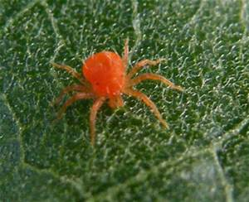
SPIDER MITE

Slide 4
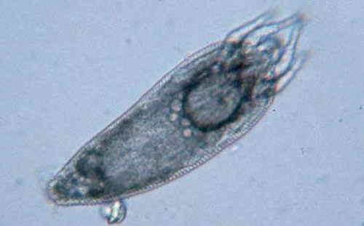
ERIOPHYID MITE
(Phyllocoptes fructiphilus)

Slide 5
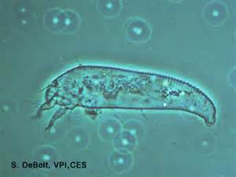
ERIOPHYID MITE
(Phyllocoptes fructiphilus)

Slide 6
ERIOPHYID MITES
1,859 SPECIES OF ERIOPHYID MITES WORLDWIDE
GENERALLY CAUSE SOME ABNORMALITY OF PLANT TISSUE, BUT MOST OF IT IS ASTHETIC RATHER THAN SERIOUS HARM
SOME MITES ARE HOST SPECIFIC, OTHER CAN LIVE IN A VARIETY OF PLANTS
THE PHYLLOCOPTES FRUCTIPHILUS MITE ONLY LIVES IN ITS HOST PLAN THE ROSE BUSH
IT IS 1/100 OF AN INCH IN LENTH AND WILL REQUIRE A 20X MAGNIFICATION TO SEE IT
REPRODUCTION IS CONTINUOUS WITH A NEW GENERATION EVERY 2-3 WEEKS WITH OVERLAPPING GENERATIONS (MALES & FEMALES PRESENT)
WILL OVERWINTER IN A ROSE BUSH

Slide 7
THE ERIOPHYID MITE
NON-INFECTED MITES ARE COMMON ON ROSES
SO SMALL IT CAN NOT BE SEEN BY THE NAKED EYE
CAN NOT FLY AND CAN ONLY CRAWL ABOUT ONE METER
BLOWN BY WIND OR HITCHHIKING ON INSECTS OR CLOTHES
CARRIES THE RRV TO ANY ROSE IT FEEDS ON
REPRODUCES EVERY 2-3 WEEKS
OVERWINTERS ON ROSE PLANT AND CAN SURVIVE COLD WINTERS

Slide 8
HOW DOES THE MITE TRANSMIT THE VIRUS
MITE WILL FEED ON ANY SPECIE OF ROSE
FEEDS DEEP WITHIN THE PLANT TISSUE SUCKING OUT JUICES AND DEPOSITING A TOXIN THAT INCLUDES THE VIRUS INTO THE PLANT
VIRUS BECOMES SYSTEMIC IN THE ROSE BUSH INCLUDING THE ROOT SYSTEM (MOVES VIA XYLEM AND PHLOEM)
VIRUS CAUSES MODIFICATIONS IN THE PLANT RNA
NEW CLEAN MITES FEED ON THE PLANT AND BECOME INFECTED

Slide 9
HOW CAN WE IDENTIFY RRD
THE VIRUS CAN CREATE DIFFERENT SYMPTOMS IN A ROSE BUSH AND IN DIFFERENT SPECIES OF ROSES
THE CHALLENGE IS TO IDENTIFY THE MOST COMMON SYMPTOMS AND THEN TO ACT QUICKLY TO PREVENT TRANSMISSION TO OTHER ROSE BUSHES.
BASIC STRATEGY IS TO CONTAIN THE MITE

Slide 10
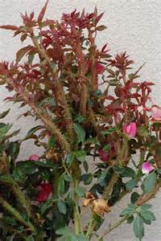
SYMPTOM 1: WITCHES BROOM

Slide 11
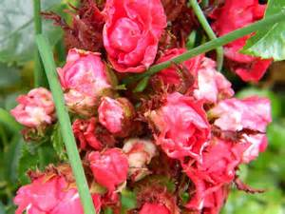
SYMPTOM 2: MALFORMED FLOWERS AND LEAVES

Slide 12

SYMPTOM 3: EXCESSIVE LEAF GROWTH

Slide 13
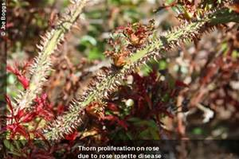
SYMPTOM 4: EXCESSIVE THORNINESS

Slide 14

SYMPTOM 5: RED DISCOLORATION

Slide 15
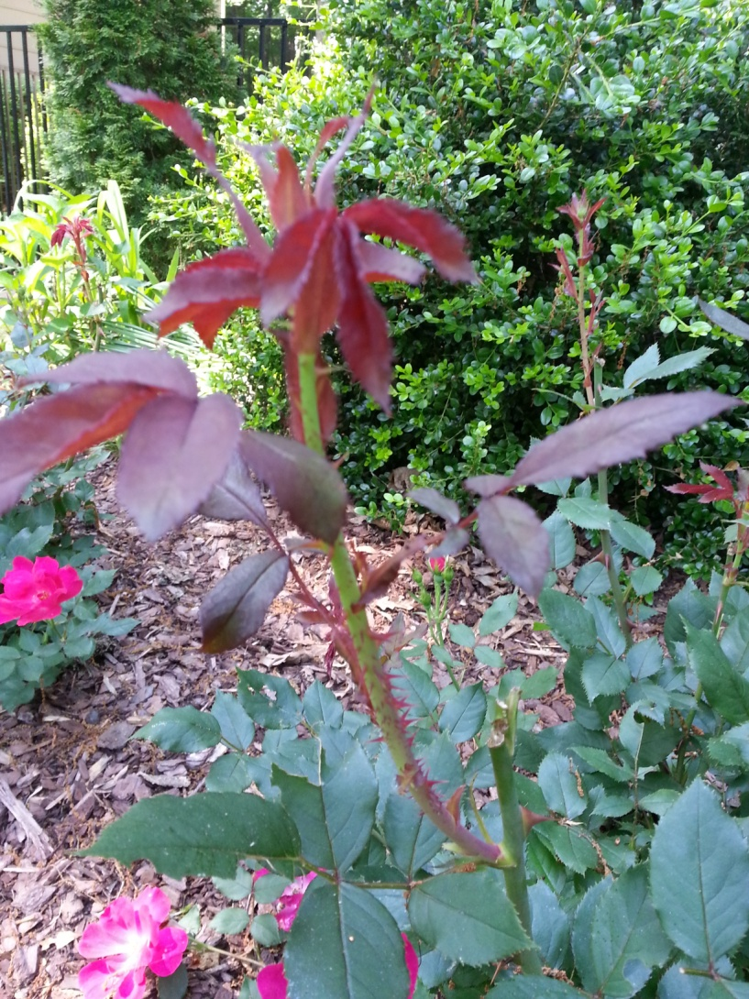
SYMPTOM 6: LATERAL SHOOT ELONGATION

Slide 16
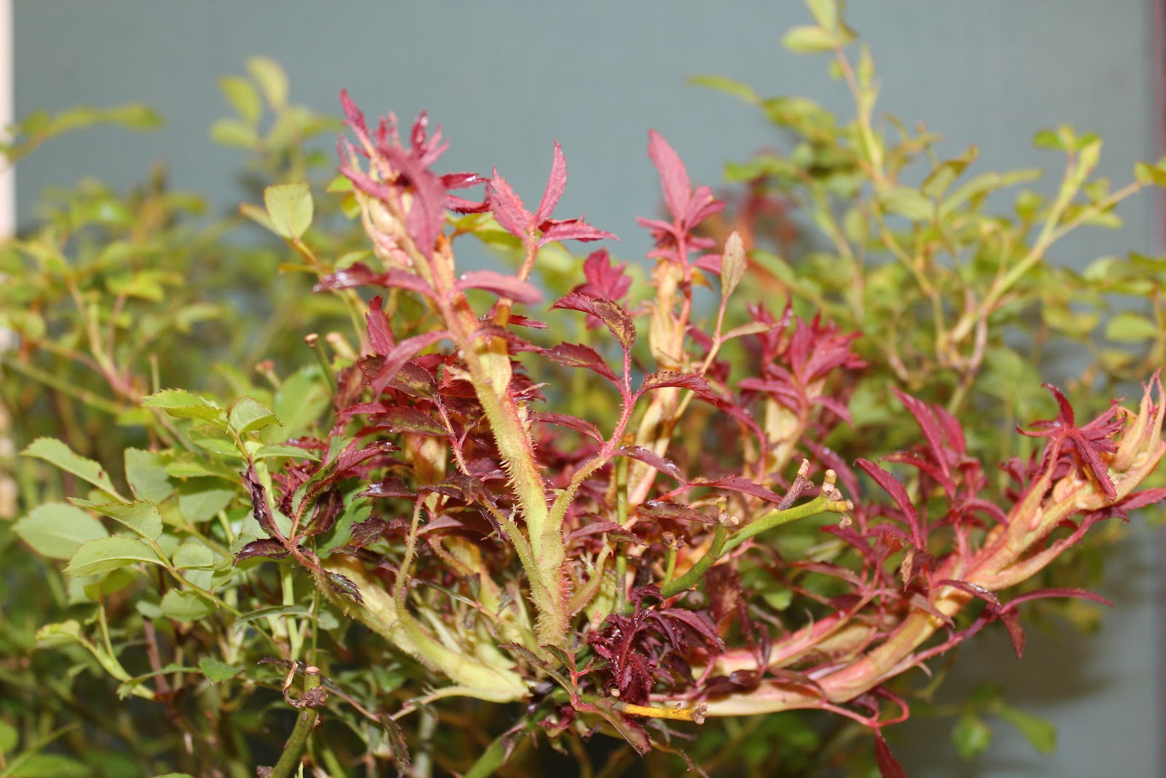
SYMPTOM 7: FLATTENED STEMS

Slide 17
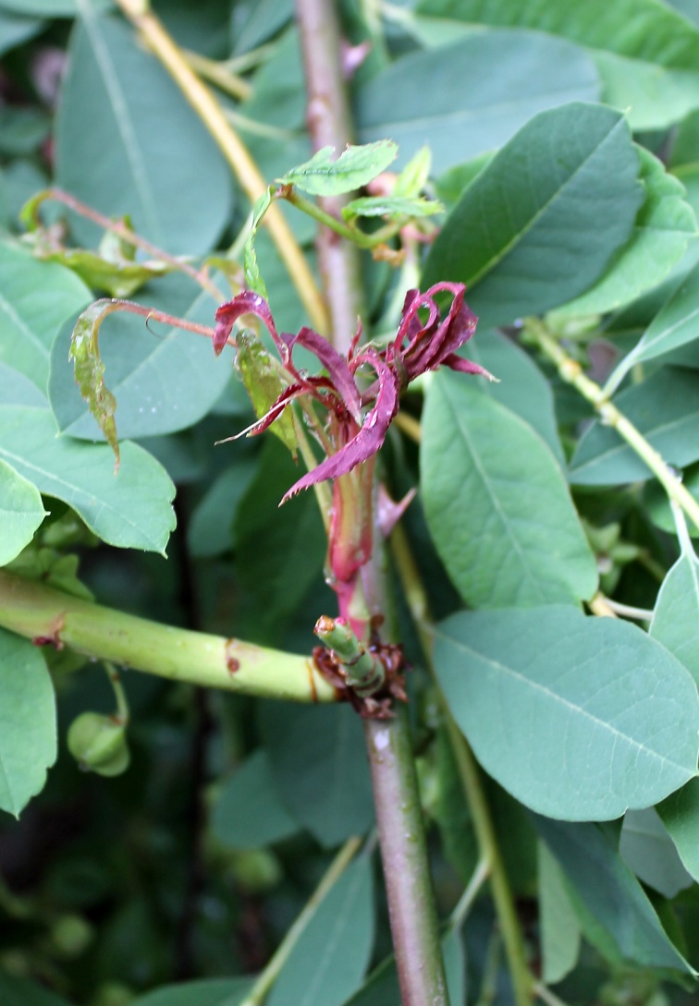
SYMPTOM 8: ENLARGED STEMS

Slide 18
TREATMENT
NO KNOWN WAY TO KILL THE VIRUS IN AN INFECTED ROSE BUSH
ROSE BUSH WILL EVENTUALLY DIE
THE VIRUS WILL DIE WHEN THE BUSH DIES, IT NEEDS A LIVE ROSE BUSH TO SURVIVE
THE MITE WILL FLEE FROM A DEAD OR DYING ROSE BUSH
THE MITE CAN ONLY LIVE ABOUT ONE WEEK IF IT IS NOT ON A ROSE BUSH

Slide 19
SOME PREVENTION ACTIONS
KNOW THE SOURCE AND HISTORY OF ANY ROSE BUSH YOU PURCHASE
DON’T PICK OUT A “CLEAN’ PLANT IN A GROUP OF INFECTED PLANTS-IT IS MOST LIKELY INFECTED
SPACE ROSE BUSHES SO THEY DO NOT TOUCH EACH OTHER-MITES WILL DIE IF THEY CAN NOT FEED ON A LIVE ROSE BUSH-USUALLY WITHIN ONE WEEK

Slide 20
STRATEGY FOR INFECTED BUSHES
THREE PART STRATEGY RECOMMENDED ONCE YOU HAVE DETERMINED THE BUSH IS INFECTED:
1. BAG IT: FIRST PUT A TRASH BAG OR PAPER RECYCLING BAG OVER THE BUSH TO CONTAIN MITES
2. DIG IT: CUT PLANT OFF AT THE GROUND AND THEN DIG OUT THE ROOT SYSTEM. GET AS MUCH OF THE ROOT SYSTEM AS POSSIBLE, MAY WANT TO WAIT SOME TIME BEFORE REPLANTING AND SPRAY ANY NEARBY BUSHES WITH A MITECIDE
3. TRASH IT: DISPOSE OF BUSH IN ACCORDANCE WITH LOCAL ORDINANCES. DO NOT PUT IN YOUR COMPOST PILE

Slide 21
GENERAL CONCLUSIONS AND RECOMMENDATION
KNOW THE SYMPTOMS OF RRD AND ACT QUICKLY ONCE YOU HAVE DETECTED AN INFECTED PLANT
THERE IS NO KNOWN CURE OTHER THAN SAFELY REMOVING THE INFECTED BUSH
TO DATE WE DO NOT KNOW IF MITICIDES, DORMANT OILS OR SOAPS HAVE AN IMPACT ON THE MITES, BUT FINDING A SPRAY THAT CAN KILL THE MITE IS A MAJOR RESEARCH FOCUS
GOOD STERILIZATION PRACTICES ARE ALSO RECOMMENDED, BUT THERE IS NOT RESEARCH INDICATING THE VIRUS IS SPREAD BY PRUNERS OR GARDEN EQUIPMENT. HOWEVER, IF A MITE GETS ON THE EQUIPMENT AND THEN IT IS USED ON ANOTHER BUSH IT COULD BE THE METHOD OF TRANSPORTATION.
KEEP UP WITH THE LATEST RESEARCH AND DEVELOPMENT

